Slide 1
Combating Addiction Effectively To Save Lives
Jeremy D. Hustead, M.D.
Addiction Psychiatry Fellow
WVU Medicine: Department of Behavioral Medicine & Psychiatry
March 10th , 2020

Slide 2
Disclosures
No financial disclosures and no pharmaceutical ties (now or future)
Addiction Psychiatry Fellow at WVU Medicine’s Chestnut Ridge Center in Morgantown
Will be joining WVU clinical faculty as an Assistant Professor in July 2020
Additionally serve at Valley Healthcare’s Crisis Unit in Morgantown
Mentors at WVU include Drs. James Berry, Patrick Marshalek, Kavara Vaughn, Wanhong Zheng, Dilip Chandran, Judith Feinberg, & Dr. Rolly Sullivan

Slide 3
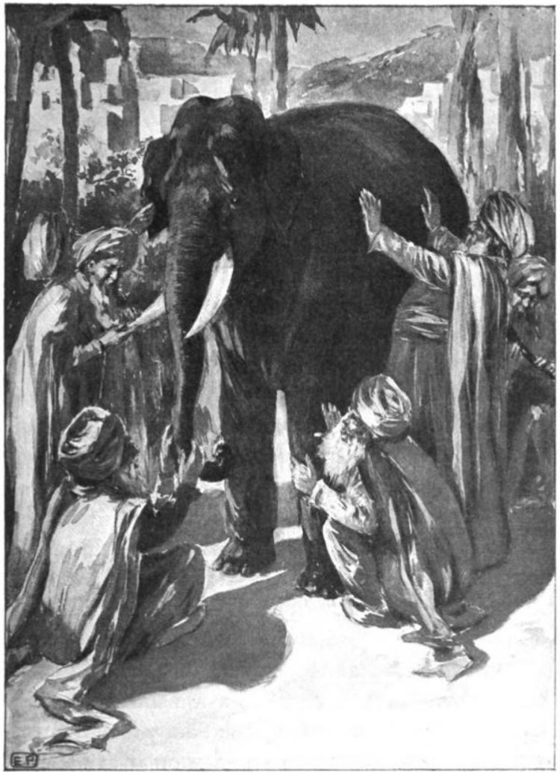
Notes:
Story of a group of blind men, who have never come across an elephant before and who learn and conceptualize what the elephant is like by touching it. Each blind man feels a different part of the elephant's body, but only one part, such as the side or the tusk. They then describe the elephant based on their limited experience and their descriptions of the elephant are different from each other. The moral of the parable is that humans have a tendency to claim absolute truth based on their limited, subjective experience as they ignore other people's limited, subjective experiences which may be equally true

Slide 4
Objectives
Review the disease of addiction and how it affects our brains
Address the barriers to treatment created by stigma
Review effective treatment options for opioid use disorder
Dispel some myths and answer any questions
Personal: Be informative, straightforward, and sincere
Only Request of you: Be open-minded

Slide 5
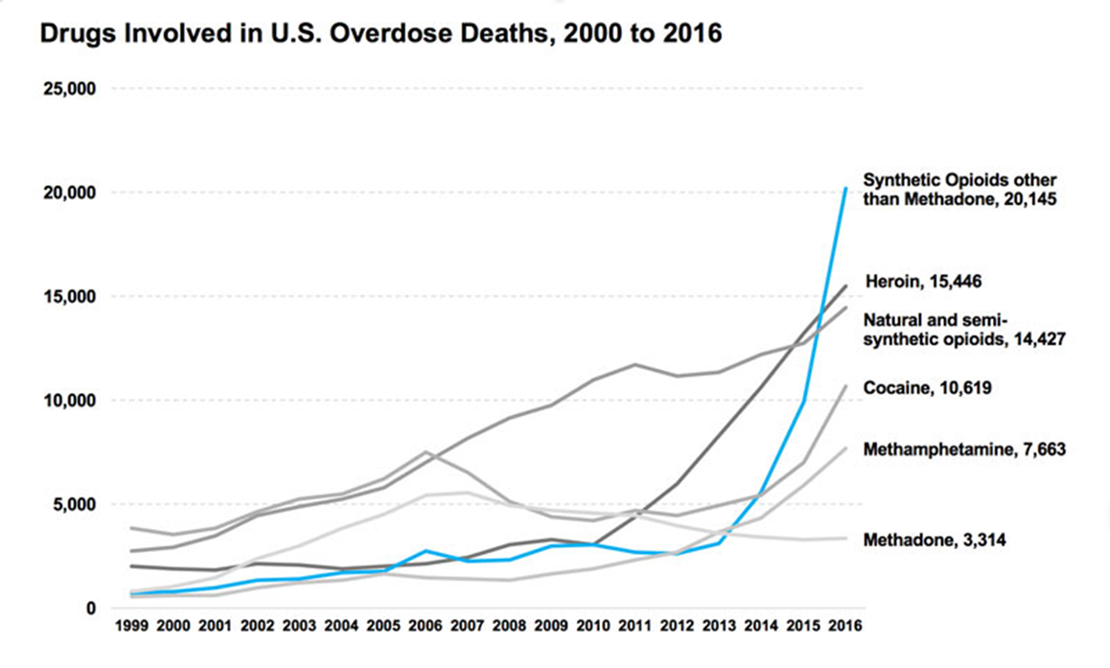
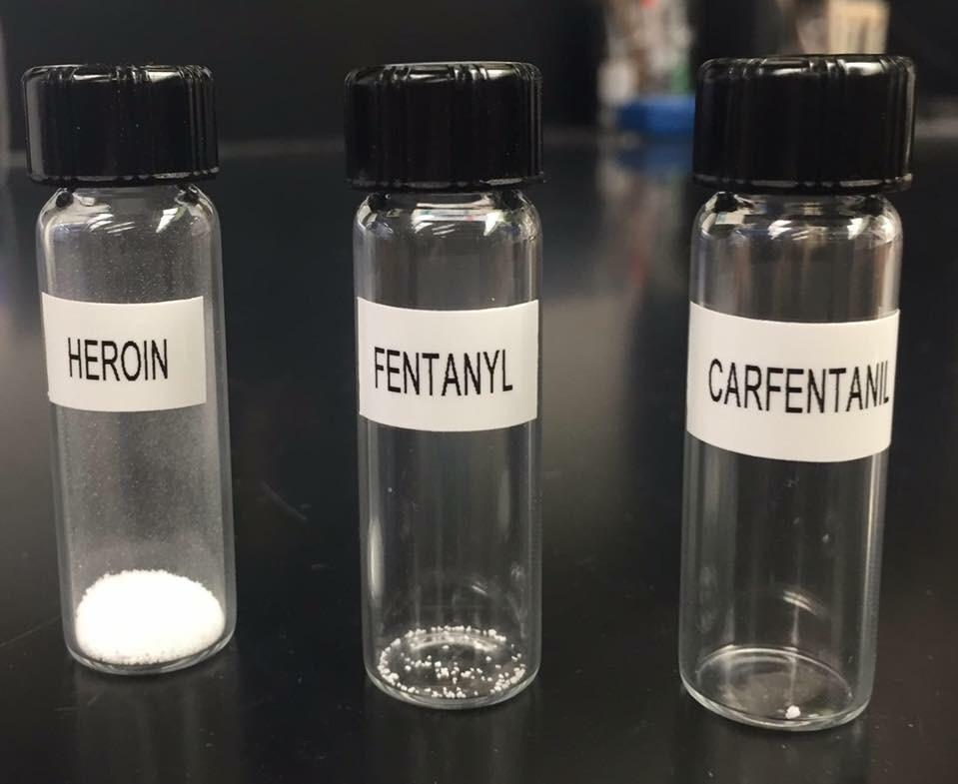
Overdose deaths
2017: 70,237 total overdoses in US

Slide 6
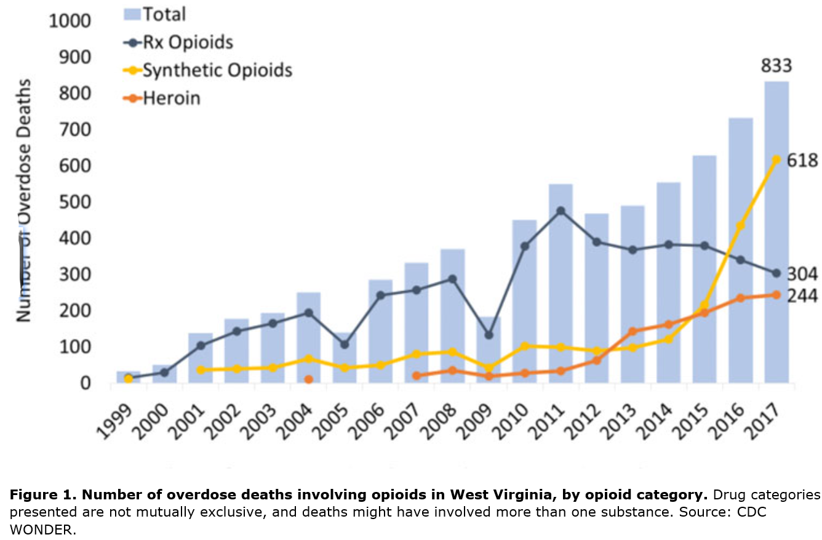
Overdose Deaths in West Virginia
Leading nation in 2017: West Virginia 57.8/100,000 deaths
  974 total overdose deaths
  833 deaths involved opioids
Besides overdoses, significant morbidity and mortality related to Hepatitis C, Endocarditis, Osteomyelitis, & Criminality
NIDA West Virginia Opioid Summary

Slide 7
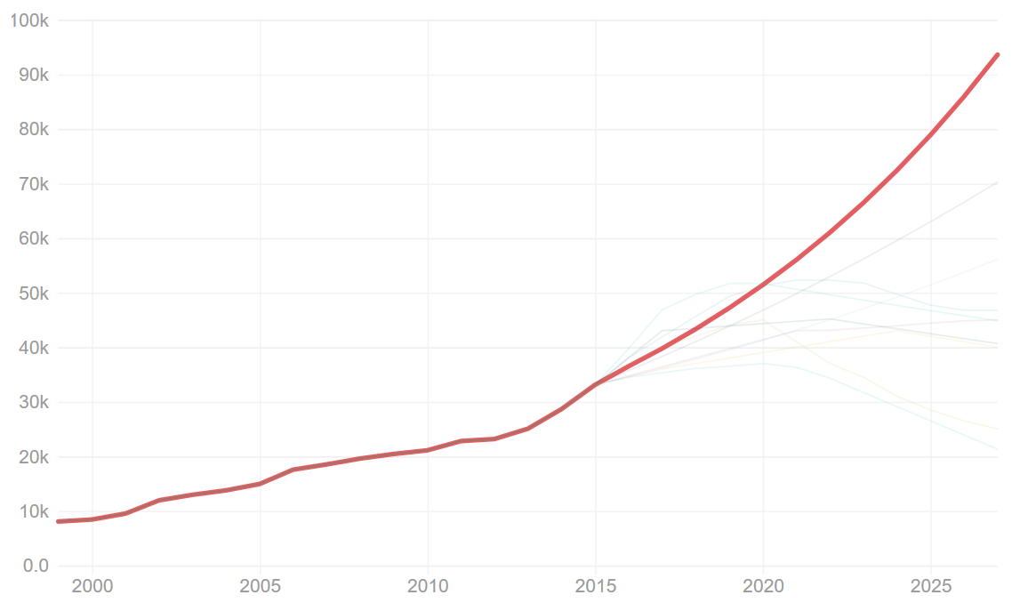
Opioid Deaths: Worst Case Scenario
STAT forecast: Opioids could kill nearly 500,000 Americans in the next decade
https://www.statnews.com/2017/06/27/opioid-deaths-forecast/
Notes:
Scenario 1: The opioid deaths forecast for 2027 is 93,613. The forecasted change is 183% since 2015 when it was 33,091. This curve assumes total drug overdoses climb at the same rate they have for decades. It’s also based on the assumption opioid deaths keep making up roughly the same percentage of all drug deaths. Natalia Bronshtein/STAT
STAT forecast: Opioids could kill nearly 500,000 Americans in the next decade
By MAX BLAU @maxblau
JUNE 27, 2017
MIKE REDDY FOR STAT
Opioids could kill nearly half a million people across America over the next decade as the crisis of addiction and overdose accelerates.
Deaths from opioids have been rising sharply for years, and drug overdoses already kill more Americans under age 50 than anything else. STAT asked leading public health experts at 10 universities to forecast the arc of the epidemic over the next decade. The consensus: It will get worse before it gets better.
There are now nearly 100 deaths a day from opioids, a swath of destruction that runs from tony New England suburbs to the farm country of California, from the beach towns of Florida to the Appalachian foothills.
In the worst-case scenario put forth by STAT’s expert panel, that toll could spike to 250 deaths a day, if potent synthetic opioids like fentanyl and carfentanil continue to spread rapidly and the waits for treatment continue to stretch weeks in hard-hit states like West Virginia and New Hampshire.
If that prediction proves accurate, the death toll over the next decade could top 650,000. That’s almost as many Americans as will die from breast cancer and prostate cancer during that time period. Put another way, opioids could kill nearly as many Americans in a decade as HIV/AIDS has killed since that epidemic began in the early 1980s. The deep cuts to Medicaid now being debated in Congress could add to the desperation by leaving millions of low-income adults without insurance, according to the nonpartisan Congressional Budget Office.
Even the more middle-of-the-road forecasts suggest that by 2027, the annual U.S. death toll from opioids alone will likely surpass the worst year of gun deaths on record, and may top the worst year of AIDS deaths at the peak of that epidemic in the 1990s, when nearly 50,000 people were dying each year. The average toll across all 10 forecasts: nearly 500,000 deaths over the next decade.
Beyond the immeasurable pain to families, the overdoses will cost the U.S. economy hundreds of billions of dollars.
In addition to the forecasts, provided by academics who specialize in epidemiology, clinical medicine, health economics, and pharmaceutical use, STAT conducted more than 40 interviews with politicians and patient advocates, providers and payers, doctors and drug makers. This analysis is also informed by a review of presentations from top Trump administration health officials, including Health and Human Services Secretary Tom Price, National Institutes of Health Director Francis Collins, and the acting chiefs of the Office of National Drug Control Policy, the Substance Abuse and Mental Health Services Administration, and the Centers for Disease Control and Prevention.
“It took us about 30 years to get into this mess,” Robert Valuck, professor at the University of Colorado-Denver’s School of Pharmacy and Pharmaceutical Sciences, told STAT. “I don’t think we’re going to get out of it in two or three.”
It’s already so bad that once unthinkable scenes of public overdose are now common: People are dying on public buses and inside fast-food restaurants. They’re collapsing unconscious on street corners and in libraries after overdosing on prescription pain pills, heroin, and fentanyl. A customer in Anchorage, Alaska, hit the floor of a Subway while trying to order a sandwich. A mom in Lawrence, Mass., sprawled in the toy aisle of a Family Dollar as her little girl screamed at her to wake up. A grandmother in East Liverpool, Ohio, slumpedin the front seat of an idling car, turning blue, while a toddler in dinosaur pajamas sat in the back.
There are so many deaths, some coroners are running out of room for bodies.
The most recent national statistics count more than 33,000 opioid-related deaths across the U.S. in 2015. Many victims are young, often in their 20s or 30s. Increasingly, many are white. But the plague touches all demographics: farmers and musicians, lawyers and construction workers, stay-at-home moms and the homeless.
Most of the forecasts produced by STAT predict the annual death toll will increase by at least 35 percent between 2015 and 2027. Under the gravest scenarios, it could triple — to more than 93,000 deaths a year.
On this, all the experts agree: Fatal overdoses will not even begin to level off until sometime after 2020, because it will take time to see whether the federal government’s efforts to boost drug enforcement and push doctors to write fewer prescriptions for opioid pain pills are effective.
The worst-case scenario is built around the assumption doctors will continue to freely prescribe and that people addicted to opioids will continue to be exposed, perhaps unknowingly, to powerful synthetic compounds like carfentanil, an elephant tranquilizer capable of killing a human with just a couple of grains.
Opioid deaths: Worst case scenario
Scenario 1: The opioid deaths forecast for 2027 is 93,613. The forecasted change is 183% since 2015 when it was 33,091. This curve assumes total drug overdoses climb at the same rate they have for decades. It’s also based on the assumption opioid deaths keep making up roughly the same percentage of all drug deaths.NATALIA BRONSHTEIN/STAT
The best-case projection has fatal overdoses falling below 22,000 a year by 2027. But experts say reaching that level would require a major public investment in evidence-based treatment options and a concerted push among medical providers to control pain with non-narcotic therapies before trying prescription opioids. Right now the U.S. spends about $36 billion a year on addiction treatment — and just a fraction of those in need are getting care.
By contrast, federal officials estimate that opioid abuse drains nearly $80 billion a year from the American economy because of expenses tied to health care, criminal justice, and lost productivity.
President Trump, who has vowed to make opioids a priority, has appointed a commission led by New Jersey Gov. Chris Christie to explore solutions, but it hasn’t yet laid out its ideas — and in the meantime, the administration’s proposed budget would slash most domestic spending, which health advocates call profoundly counterproductive.
“Are we doing enough of what we think works — prescription drug monitoring programs, medication-assisted treatment, naloxone?” asked Dr. Donald Burke, dean of the University of Pittsburgh’s graduate school of public health.
“And,” Burke said, “are we matching the societal costs with a like expenditure in prevention?”
Opioid deaths: Best case scenario
Scenario 10: The opioid deaths forecast for 2027 is 21,300. The forecasted change is -36% since 2015 when it was 33,091. ‎‎This curve assumes doctors prescribe fewer opioids, states embrace prescription drug monitoring programs, and insurers enact reforms to increase treatment access.NATALIA BRONSHTEIN/STAT
Ignoring clear signs of danger
The STAT analysis projects many painful years ahead. The roots of the crisis, though, stretch back generations to the 1980s, when pharmaceutical firms first marketed prescription opioids like oxycodone and hydrocodone to treat pain — and claimed they carried minimal risk for addiction.
Over the years these companies pushed hard to get pills in patients’ hands with strategies that included paying middlemen to circumvent state regulations and allegedly bribing doctors to prescribe opioids.
The result are staggering: Opioid prescriptions nearly tripled between 1991 and 2011.
It has been abundantly clear in recent years that such prescriptions can be dangerous. From 2005 to 2014, the rate of opioid-related emergency department visits nearly doubled, according to a new report from the Agency for Healthcare Research and Quality. Yet as recently as 2015, doctors prescribed prescription painkillers to more than a third of American adults, despite limited upside for many patients.
HYACINTH EMPINADO/STAT
“It’s like cigarettes in the ’50s: We look back at the way people smoked and promoted cigarettes as laughably backwards — magazine ads with doctors saying, ‘Physicians prefer Camels,” Dr. Michael Barnett, assistant professor of health policy and management at Harvard University, said.
“We have the same thing now — Oxycontin ads in medical journals where doctors would say, ‘Opioids are good for treating pain. They don’t have addictive potential.’ It’s possible 20 years from now, we’re going to look back and say, ‘I cannot believe we promoted these dangerous, addictive medications that are only marginally more effective.’”
The state of Ohio, among a handful of governments currently suing drug makers, alleges that a “well-funded marketing scheme” led to its residents receiving 3.8 billion opioid pills from 2011 to 2015, fueling “human tragedy of epic proportion.” Fatal drug overdoses in Ohio have soared by 642 percent since the turn of the millennium.
Another statistic: The number of privately insured patients diagnosed with opioid dependence increased nearly sixfold in just five years, according to data compiled by Amino, a health care data analytics company.
In 2012, only 241,000 such patients had an opioid dependency diagnosis. By 2016, that number was 1.4 million. And those numbers don’t even account for the hundreds of thousands more battling addictions while on Medicaid or Medicare, or while uninsured.
The surging death toll, affecting growing numbers of white Americans, sparked demand for action in ways unseen during past epidemics that disproportionately affected minority populations. Law enforcement officers started shutting down pain clinics, known as “pill mills,” where doctors accepted cash for painkiller prescriptions. But that only accelerated demand for heroin, as pill mill patients had trouble finding treatment to break free from their addictions.
Desperate to keep feeding their cravings and avoid the anguish of withdrawal, people from all walks of life — soccer moms in Vermont, C-suite execs in California, college-bound kids in West Virginia — began to shift from prescription pills to heroin, which was more potent and had become far cheaper, thanks to heightened drug trafficking into the U.S. by cartels. Two years ago, heroin deaths surpassed the toll from prescription opioids for first time this millennium, according to the Washington Post.
“Thirty years ago, the heroin dealers drove through Arkansas” on their way to more populous and lucrative markets, Dr. G. Richard Smith, professor of psychiatry, medicine, and public health at the University of Arkansas for Medical Sciences, told STAT. “That’s not the case now: People are switching from legal prescription meds, rightly or wrongly prescribed, to heroin.”
HYACINTH EMPINADO/STAT
A new threat rises
Many of the experts STAT spoke with were even more concerned about the wave now crashing through communities: the synthetic opioids, such as fentanyl and carfentanil, that have flooded into the U.S. from China and Mexico. They can be cheaper and even deadlier than heroin — and can be made at home or ordered online. Between 2013 and 2015, deaths linked to these potent opioids tripled to more than 9,000.
The drugs can be so deadly, the U.S. Drug Enforcement Agency this month urgedfirst responders to carry naloxone in case they accidentally overdose while trying to help a victim — as has already happened to officers in Ohio and Maryland. The DEA also recommended first responders wear protective equipment such as safety goggles and masks, and in some cases full hazmat suits.
Because they’re so strong, synthetic opioids have spawned strings of mass overdoses in cities throughout the eastern half of the U.S.
Drug maker thwarted plan to limit OxyContin prescriptions at dawn of opioid epidemic
Last summer emergency workers in Cincinnati responded to an unprecedented 174 overdoses in six days; this past winter, paramedics in Louisville scrambled to get to 151 overdoses over four days. In the small city of Huntington, W. Va., reports of 28 overdoses in five hours last August forced 911 dispatchers to send out every available ambulance to revive drug users who had passed out inside homes and on highways.
And the most potent synthetic opioids haven’t even penetrated all the markets in the U.S. yet.
“We’ve not seen the worst yet,” said Tim Robinson, CEO of Addiction Recovery Care, a Louisa, Ky.-based company that runs several rehab programs. “As we transition from heroin toward fentanyl and carfentanil, when it hits the rural areas in Appalachia, we’re going to see a lot more devastation.”
Already, a long trend of declining death rates for young adults has been reversed: Death rates for people ages 25 to 44 increased from 2010 to 2015 in nearly every racial and ethnic group, in large part because of drug and alcohol abuse, the Washington Post found. The New York Times recently reached out to hundreds of state and county health officials to piece together an estimate of total drug overdose deaths last year. Its projection: More than 59,000 fatalities, most from opioids.
HYACINTH EMPINADO/STAT
In an interview with STAT at a national drug abuse summit earlier this year, Dr. Patrice Harris, then chair of the American Medical Association, said one key to bringing down the death toll is to spread the word that addiction is a chronic medical condition, not a personal failing.
Another key: getting more people access to medications that can reduce cravings, such as buprenorphine, methadone, and naltrexone — and convincing both patients and providers that such treatments don’t simply amount to trading one addiction for another.
“Any physician in this country can prescribe oxycodone in high doses, but they can’t prescribe buprenorphine unless they have special training,” said medical epidemiologist Jay Unick of the University of Maryland, Baltimore. “You just don’t have easy access to buprenorphine. And that’s crazy in a world flooded with opioids.”
The end result: waiting lists for treatment that can stretch for weeks or months.
In West Virginia, Marshall University student Taylor Wilson tried for 41 days to get treatment after nearly dying from an overdose. Her mother, Leigh Ann Wilson, finally got a call saying Taylor had cleared a buprenorphine waiting list. Her daughter had died four days earlier, from another overdose.
A landmark report last year from then-Surgeon General Vivek Murthy found only 10 percent of the estimated 2.2 million Americans with an opioid-use disorder have received addiction treatment.
“We know what works,” Murthy said this past April. “We’re just not doing enough of it.”

Slide 8
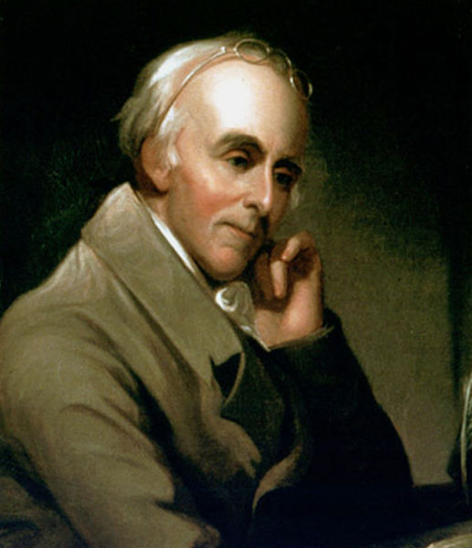
DISEASE Model of Addiction
“My observations authorize me to say, that persons who have been addicted to them, should abstain from them suddenly and entirely. 'Taste not, handle not, touch not' should be inscribed upon every vessel that contains spirits in the house of a man, who wishes to be cured of habits of intemperance, …habitual drunkenness should be regarded not as a bad habit but as a disease.”
Dr. Benjamin Rush
Notes:
The American physician Benjamin Rush (1745-1813), a signer of the United States Declaration of Independence -- who understood drunkenness to be what we would now call a "loss of control" -- was, perhaps, the first to use the term "addiction" in this sort of meaning.[9]
My observations authorize me to say, that persons who have been addicted to them, should abstain from them suddenly and entirely. 'Taste not, handle not, touch not' should be inscribed upon every vessel that contains spirits in the house of a man, who wishes to be cured of habits of intemperance.[10]
Rush argued that "habitual drunkenness should be regarded not as a bad habit but as a disease" -- essentially a disturbed, distressed, and uncomfortably destabilized condition (i.e., dys-ease) rather than an actual illness -- describing it as "a palsy of the will".[11]
Rush’s contribution to a new model of habitual drunkenness was fourfold: First, he identified the causal agent—spiritous liquors; second, he clearly described the drunkard’s condition as a loss of control over drinking behavior—as compulsive activity; third, he declared the condition to be a disease; and fourth, he prescribed total abstinence as the only way to cure the drunkard.[12]

Slide 9
Addiction as a Brain DISEASE
Addiction is a primary, chronic disease of brain reward, motivation, memory and related circuitry. It is characterized by one or more of the following (ABCDE):
  Inability to consistently Abstain
  Impairment in Behavioral control
  Craving
  Diminished recognition of problems
  Dysfunctional Emotional response
American Society of Addiction
Medicine Public Policy Statement
Notes:
Public Policy Statement: Definition of Addiction
Short Definition of Addiction:
Addiction is a primary, chronic disease of brain reward, motivation, memory and related circuitry. Dysfunction in these circuits leads to characteristic biological, psychological, social and spiritual manifestations. This is reflected in an individual pathologically pursuing reward and/or relief by substance use and other behaviors.
Addiction is characterized by inability to consistently abstain, impairment in behavioral control, craving, diminished recognition of significant problems with one’s behaviors and interpersonal relationships, and a dysfunctional emotional response. Like other chronic diseases, addiction often involves cycles of relapse and remission. Without treatment or engagement in recovery activities, addiction is progressive and can result in disability or premature death.
inability to consistently abstain
impairment in behavioral control
craving
diminished recognition of significant problems with one’s behaviors and interpersonal relationships
and a dysfunctional emotional response
American Academy of Pain Medicine, American Pain Society, American Society of Addiction Medicine: Definitions Related to the Use of Opioids for the Treatment of Pain. American Academy of Pain Medicine, American Pain Society, American Society of Addiction Medicine, 2006
Commonality with Chronic Pain and Addiction: Patient “eating” or snorting.
Similarities between Addiction and Chronic Pain:
Patient’s effort to feel better often leads to feeling worse
Central organizing principle
“Powerlessness and unmanageability”
Patients blamed and criticized for their condition
Stigma
Enabling by others
Prior to treatment both groups tend to be defensive, projective of blame, closed-minded, angry, in denial
High incidence of depression, anxiety, suicide

Slide 10
Addiction as a Brain DISEASE
Cycle of relapse and remission
This disease is often progressive and fatal
Contain vs. Cure addiction
Two main goals for physicians:
  Keep our patients alive
  Increase the quality of their life
Notes:
Public Policy Statement: Definition of Addiction
Short Definition of Addiction:
Addiction is a primary, chronic disease of brain reward, motivation, memory and related circuitry. Dysfunction in these circuits leads to characteristic biological, psychological, social and spiritual manifestations. This is reflected in an individual pathologically pursuing reward and/or relief by substance use and other behaviors.
Addiction is characterized by inability to consistently abstain, impairment in behavioral control, craving, diminished recognition of significant problems with one’s behaviors and interpersonal relationships, and a dysfunctional emotional response. Like other chronic diseases, addiction often involves cycles of relapse and remission. Without treatment or engagement in recovery activities, addiction is progressive and can result in disability or premature death.
inability to consistently abstain
impairment in behavioral control
craving
diminished recognition of significant problems with one’s behaviors and interpersonal relationships
and a dysfunctional emotional response
American Academy of Pain Medicine, American Pain Society, American Society of Addiction Medicine: Definitions Related to the Use of Opioids for the Treatment of Pain. American Academy of Pain Medicine, American Pain Society, American Society of Addiction Medicine, 2006
Commonality with Chronic Pain and Addiction: Patient “eating” or snorting.
Similarities between Addiction and Chronic Pain:
Patient’s effort to feel better often leads to feeling worse
Central organizing principle
“Powerlessness and unmanageability”
Patients blamed and criticized for their condition
Stigma
Enabling by others
Prior to treatment both groups tend to be defensive, projective of blame, closed-minded, angry, in denial
High incidence of depression, anxiety, suicide

Slide 11
Addiction = Substance Use Disorder
Substance use ≠ Substance Use Disorder
Recreational Use → At Risk use → Dependency
A disorder causes clinically significant distress or impairment in social, occupational, or other important areas of functioning
During active use, we cannot diagnose other mental health conditions that share similar symptoms, for example:
  Methamphetamine use and Bipolar disorder
  Synthetic marijuana and Schizophrenia
  Alcohol and depression

Slide 12
Opioid Use Disorder (OUD)
ASAM National Practice Guideline June 1st, 2015:
“Opioid use disorder is a chronic, relapsing disease, which has significant economic, personal, and public health consequences… ASAM views addiction as a fundamental neurological disorder of ‘‘brain reward, motivation, memory, and related circuitry,’’ and recognizes that there are unifying features in all cases of addiction, including substance-related addiction and nonsubstance related addiction. It is clear that a variety of substances commonly associated with addiction work on specific receptors in the nervous system and on specific neurotransmitter systems.”

Slide 13
Addiction as a Neurological Disease
Addiction = A fundamental neurological disorder
  Parkinson’s disease, Alzheimer’s disease, Epilepsy etc.
Brain imaging data clearly reveals significantly changes in the brain of a patient who suffers from an addictive disorder
Addiction lives in the brain reward pathways and is fueled by dopamine
So where and why exactly does it have such a hold on those that struggle?

Slide 14
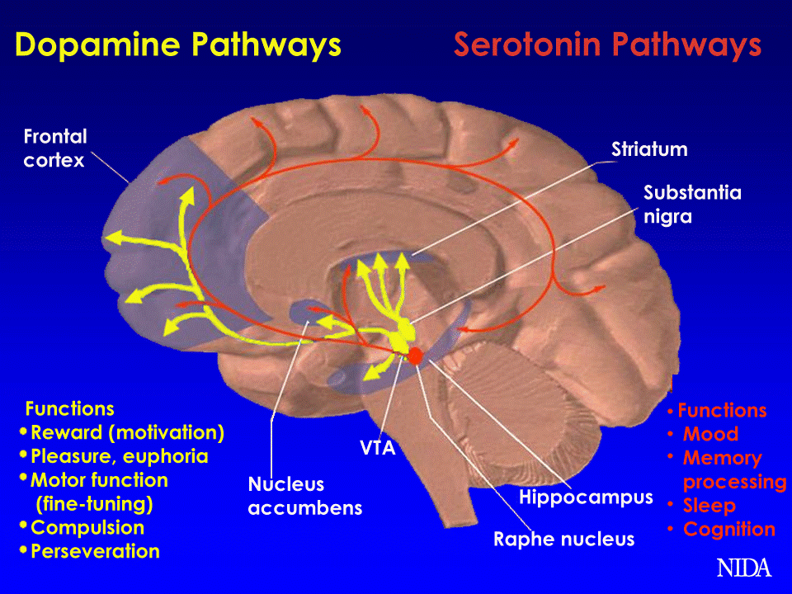
Notes:
3 parts of brain –back to fron
Cerebral Cortex
Morality
Personality
Conscious choice
Midbrain
Amoral
Reflexive
Instinctual
Survival!

Slide 15
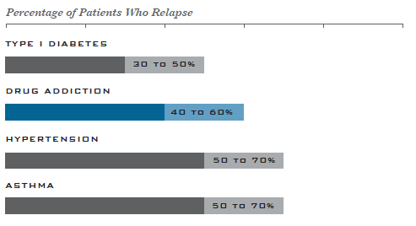
Compared to other Chronic Diseases
NIDA

Slide 16
Comparing OUD to Another Disease
Opioid Use Disorder
Lung Cancer
Starts with Exposure to a chemical (Opioids)
Takes months to years to develop opioid dependency
Is fatal if allowed to progress (overdose, endocarditis, hepatitis C, assault, etc.)
Is treatable with Medications
~ 50% recovery rate with MAT treatment
Enormous amount of Stigma
  Treatment > Disease
Starts with Exposure to a chemical (Tobacco)
Takes years for cancer to grow and to spread throughout the body
Is fatal if allowed to progress (from the cancer or the treatment)
Is treatable with Medications
~ 50% Survival rate with treatment
Very little stigma with disease or its treatment (used to be Stigmatized)
Notes:
Lung Cancer 150,000
Opioid 30,000

Slide 17
Stigma in Substance Use
Stigma is real and prevalent in the treatment of substance use disorders
Many otherwise good people who are involved in treating addiction still view addiction as simply a bad habit/choice and not as a disease
Viewing something as a bad habit/choice rather then a disease has to change the way we approach both the person and their treatment
Stigma has greatly effected access to care and driven substance users away from seeking effective care

Slide 18
Stigma and Addiction
3 Key Questions for us to consider:
Question #1:
What is the closest, non-romantic connection, two people can ever have?
Question #2:
What other disease leads a mother to continue to do something over having their children?
Question #3:
Who in their “right mind” would every choose a drug over their child?

Slide 19
Pause on Addiction as a Disease
Diagnosing someone with a disease does not take away all their responsibility
A patient with addiction should be expected to, like any other disease:
  Seek effective treatment
  Stay adherent to that treatment
  Help us to identify any other problems that exist
Unfortunately, often when they do seek treatment; it is unavailable or unoffered
If they do receive treatment, they are often pressured to stop treatment too soon

Slide 20
Opioid treatment Options
Do Nothing, Let them Die → Unethical
Detox only → Rarely works (~95% relapse rate)
Detox + 28 day Program → Sometimes works (10-15%)
Medication Assisted Treatment → Usually works
  ~50% No relapses
  80-90% treatment retention

Slide 21
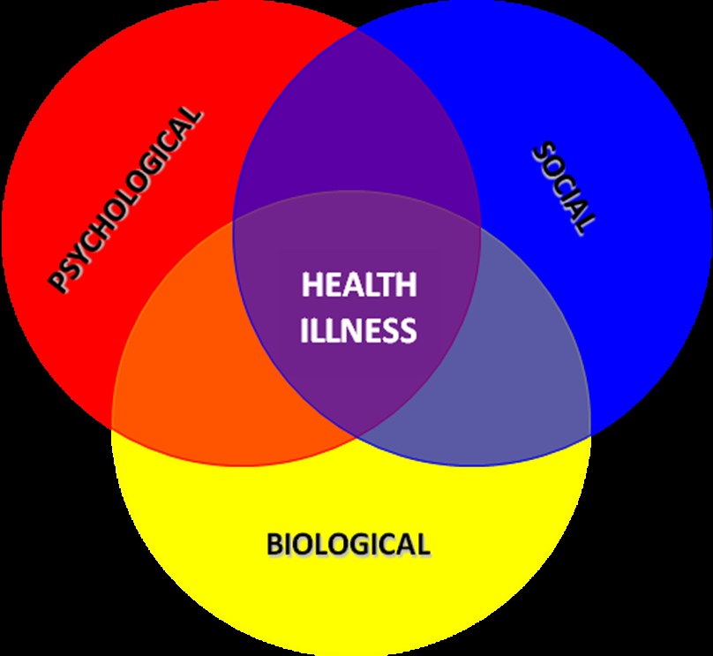
Effective TREATMENT OPTIONS
PSYCHOLOGICAL
Cognitive Behavioral Therapy, Motivational Enhancement Therapy, Group Therapy, Contingency Management
SOCIAL
Peer recovery coaches & groups (NA, AA, Celebrate Recovery, Smart Recovery)
Family Therapy, Spiritual Community
Drug courts, Professional help programs
BIOLOGICAL
“Abstinence-Based”
Medication Assisted Treatment (MAT)
PLUS
Versus
Notes:
We are not islands
Abstinence = ignoring biological
False dichotomy

Slide 22
MAT for Opioid Use Disorder
In 2015 ~2.4 million Americans had an Opioid Use Disorder.¹
  ~80% did not receive treatment!²
MAT is a safe and effective strategy for decreasing the frequency and quantity of opioid use and reducing the risk of overdose and death.^{3,4}
Although MAT has significant evidence to support it as an effective treatment, it remains highly underutilized ⁵ and stigmatized!
So why do we use MAT ?
1.U.S. Department of Health and Human Services, Substance Abuse and Mental Health Services Administration. (2016). Key substance use and mental health indicators in the United States: Results from the 2015 National Survey on Drug Use and Health (HHS Publication No. SMA 16-4984, NSDUH Series H-51). Rockville, MD
2. U.S. Department of Health and Human Services, Substance Abuse and Mental Health Services Administration. (2016). Prescription drug use and misuse in the United States: Results from the 2015 National Survey on Drug Use and Health. Rockville, MD.
3. Kresina TF, Lubran RL. Improving public health through access to and utilization of medication assisted treatment. Int J Environ Res Public Health. 2011;8:4102-4117
4. National Institutes on Drug Abuse. Cost effectiveness of drug treatment. Retrieved from: http://www.drugabuse.gov/publications/teaching-packets/understanding-drug-abuse-addiction/sectioniv/6-costeffectiveness-drug-treatment
5. Volkow ND1, Frieden TR, Hyde PS, Cha SS. Medication-assisted therapies--tackling the opioid-overdose epidemic. N Engl J Med. 2014 May 29;370(22):2063-6. doi: 10.1056/NEJMp1402780. Epub 2014 Apr 23.
Notes:
In 2015, nearly 2.4 million Americans had an opioid use disorder¹ and close to 80 percent of these individuals did not receive treatment.²
U.S. Department of Health and Human Services, Substance Abuse and Mental Health Services Administration. (2016). Key substance use and mental health indicators in the United States: Results from the 2015 National Survey on Drug Use and Health (HHS Publication No. SMA 16-4984, NSDUH Series H-51). Rockville, MD. Retrieved from http://www.samhsa.gov/data/sites/default/files/NSDUH-FFR1-2015/NSDUH-FFR1-2015/NSDUH-FFR1-2015.htm.
U.S. Department of Health and Human Services, Substance Abuse and Mental Health Services Administration. (2016). Prescription drug use and misuse in the United States: Results from the 2015 National Survey on Drug Use and Health. Rockville, MD. Retrieved from http://www.samhsa.gov/data/sites/default/files/NSDUH-FFR2-2015/NSDUH-FFR2-2015.htm.

Slide 23
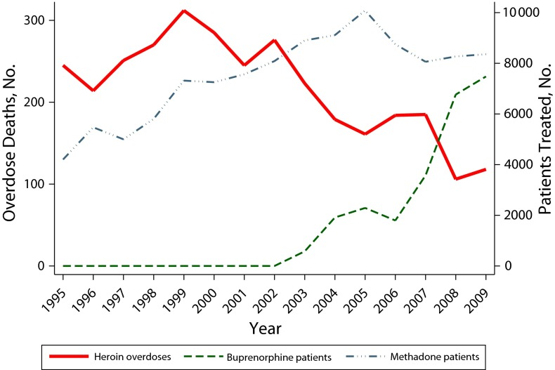
DECREASES OVERDOSE
Heroin overdose deaths and opioid agonist treatment: Baltimore, MD, 1995–2009
Notes:
OBJECTIVES:
We examined the association between the expansion of methadone and buprenorphine treatment and the prevalence of heroin overdose deaths in Baltimore, Maryland from 1995 to 2009.
METHODS:
We conducted a longitudinal time series analysis of archival data using linear regression with the Newey-West method to correct SEs for heteroscedasticity and autocorrelation, adjusting for average heroin purity.
RESULTS:
Overdose deaths attributed to heroin ranged from a high of 312 in 1999 to a low of 106 in 2008. While mean heroin purity rose sharply (1995-1999), the increasing number of patients treated with methadone was not associated with a change in the number of overdose deaths, but starting in 2000 expansion of opioid agonist treatment was associated with a decline in overdose deaths. Adjusting for heroin purity and the number of methadone patients, there was a statistically significant inverse relationship between heroin overdose deaths and patients treated with buprenorphine (P = .002).
CONCLUSIONS:
Increased access to opioid agonist treatment was associated with a reduction in heroin overdose deaths. Implementing policies that support evidence-based medication treatment of opiate dependence may decrease heroin overdose deaths.

Slide 24
DECREASES HIV INFECTIONS
Meta-analysis
9 studies
Overall:
  54% reduction
North America:
  62% reduction
Gowing et al. BMJ 2012
Notes:
Methadone
Scott Indiana –HIV Outbreak
Next outbreak: here

Slide 25
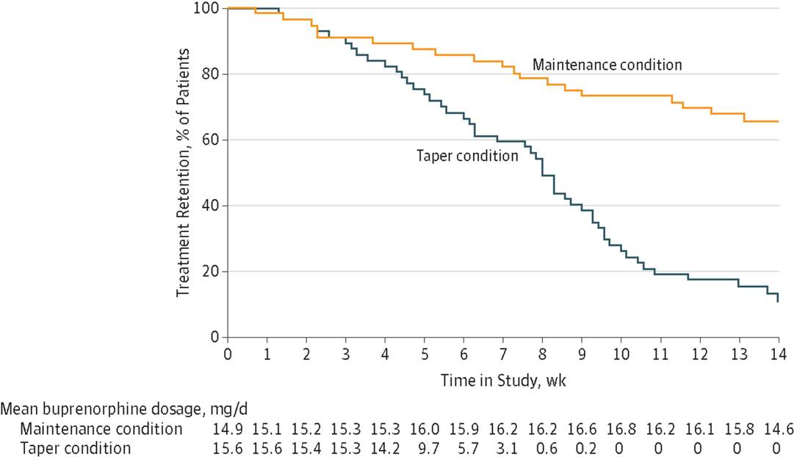
INCREASES TREATMENT RETENTION
Completion of 14 week trial:
11% taper
vs
66% maintenance
Mean percentage of urine negative for opioids:
35% taper
vs
53% maintenance
Fiellin DA et al. JAMA Intern Med 2014
Notes:
From: Primary Care–Based Buprenorphine Taper vs Maintenance Therapy for Prescription Opioid Dependence: A Randomized Clinical Trial
Treatment Retention and Mean Buprenorphine Dosage for Patients With Prescription Opioid Dependence Patients were assigned to the taper or the maintenance condition. Buprenorphine treatment was administered as a tablet formulation of buprenorphine hydrochloride and naloxone hydrochloride in a 4:1 ratio.

Slide 26
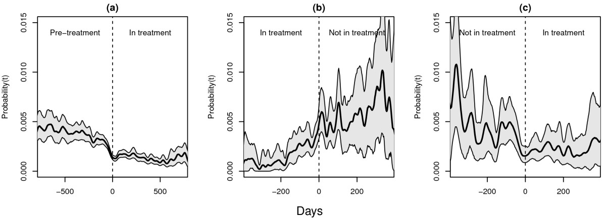
DECREASES CRIMINALITY
National cohort study of all patients (n = 3221) in OMT in Norway 1997-2003
Day-to-day rates of criminal convictions. Day-to-day rates of criminal convictions (95% CI) for all patients (a) entering OMT for the first time, (b) leaving OMT and (c) re-entering OMT. a: X-axis; days before and days after first treatment entry (n=3221). Y-axis; the day-to-day rate of criminal convictions. b: X-axis; days before and days after treatment drop out (n=1175). Y-axis; the day-to-day rate of criminal convictions. c: X-axis; days before and days after treatment re-entry (n=515). Y-axis; the day-to-day rate of criminal convictions.
Notes:
Methods
National cohort study of all patients (n = 3221) in OMT in Norway 1997-2003. Patients were followed over a 9-year period, before, during, and after treatment. Criminal convictions were studied on a day-to-day basis in relation to treatment status. A time-continuous estimate of the probability of convictions within the population for all days during observation was calculated.
Results
Changes in convictions were evident before changes of treatment status. During the 3 years prior to OMT, the convictions rate was approximately 0.4% per day. Prior to OMT, convictions decreased to about 0.2% per day on the day of treatment initiation. During the weeks before dropping out of treatment, convictions increased. The patterns during periods of transition were the same across gender, age and pre-treatment conviction-levels.
Conclusions
Changes in convictions often occurred prior to changes in treatment status. Reductions in criminal convictions were found in the period before entry (or re-entry) to OMT, and increases in criminal activity were found in the months prior to treatment interruption.
Prior to first treatment entry, the rate of criminal convictions was generally high, with a daily rate of criminality within the cohort of approximately 0.4% per day (Figure 1a). However, about three months prior to treatment initiation, the rate of criminal convictions gradually fell to a lower level, at about 0.2% per day at the day of treatment initiation. This lower level was maintained throughout most of the treatment period (Figure 1a).
During the two months prior to treatment termination the rate of convictions again gradually rose, reaching a higher level around the day of treatment dropout. This increased level prior to treatment dropout is somewhat higher than the pre-treatment level but with wide confidence intervals due to fewer observations with 35% (n = 1175) of patients dropping out at least once (Figure 1b). For those drug users who re-entered treatment, this higher crime level after leaving treatment was continued until approximately three months before re-entering treatment, when it again fell to a lower level of about 0.2% (Figure 1c). Compared to the period prior to the first episode of treatment, the rate of criminal convictions was higher during the period before re-entering OMT.
There was a slight gender difference with a significantly higher level of criminal activity among men as compared to women. Consequently the differences between in-treatment and out of treatment periods were less marked among women. When data were stratified by age groups, the middle age-group (30-40 years) had a rate of convictions similar to the mean of the total cohort. In comparison, patients under 30 had a slightly higher level, and those over 40 had a slightly lower level. When data were stratified by pre-treatment levels of criminal convictions, the high conviction group had a substantially elevated risk of criminal convictions compared to patients with no or medium criminal convictions during the entire period of observation. The medium conviction group had a time continuous pattern similar to that of the overall mean, but with somewhat less crime out of treatment, i.e. a less obvious difference between in and out of treatment. Similar time-related patterns of convictions were found for all age subgroups.
The main finding in this study was that although conviction rates were broadly related to treatment status (in and out of treatment), changes in criminal behaviour tended to occur gradually and did not coincide in any precise way with entry to treatment or leaving treatment. Changes in criminal convictions were already evident before changes of treatment status. Reductions in criminal convictions were found in the period before entry (or re-entry) to OMT, and increases in criminal activity were found in the months prior to treatment interruption. As in other studies [9, 13], the rates of criminal convictions continued to be relatively low when patients were in treatment, whereas outside of treatment the rates of criminal convictions continued to be relatively high. Although different levels in criminal convictions were found both before and after treatment entry for patients differing in age, gender and pre-treatment convictions, the same overall pattern of change was evident for all sub-groups.

Slide 27

Decreases Health Care Costs
Annual societal cost associated OUD1:
  $55 Billion
    Lost work productivity (46%)
    Health Care (45%)
    Criminal Justice (9%)
    Hidden cost of comorbid conditions
      ~8X greater health care than non-abuser
B-MAT more cost effective than:
  No treatment2
  Detox3
Immediate access to OAT = $78,257 in savings5
lifetime savings = $3.8 billion5
B-MAT Non-Adherent Cost4:
  $27k greater medical charges
  $22k greater overall healthcare charges
  1.H.G. Birnbaum, A.G. White, M. Schiller, T. Waldman, J.M. Cleveland, C.L. Roland
  Societal costs of prescription opioid abuse, dependence, and misuse in the United States
  Pain Medicine, 12 (2011), pp. 657–667
  2.B.R. Schackman, et. al. Cost-effectiveness of long-term outpatient buprenorphine-naloxone treatment for opioid dependence in primary care.Journal of General Internal Medicine, 27 (2012), pp. 669–676
  3. D. Polsky, et.al.Cost-effectiveness of extended buprenorphine-naloxone treatment for opioid-dependent youth: Data from a randomized trialAddiction, 105 (2010), pp. 1616–1624
4.Tkacz, J, et.al. Relationship between buprenorphine adherence and health service utilization and costs among opioid dependent patients.Journal of Substance Abuse Treatment (2013).
5.Krebs E, Enns B, Evans E, et al. Cost-effectiveness of publicly funded treatment of opioid use disorder in California [published online November 21, 2017]. Ann Intern Med.
Notes:
The treatment of opioid dependence with B-MAT has been shown to be more cost effective than no treatment (Schackman, Leff, Polsky, Moore, & Fiellin, 2012), detoxification treatment (Polsky et al., 2010), and likely equivalent to methadone treatment (Center for Health Program Development and Management, 2007).
Results of the multivariate analyses revealed that the B-MAT non-adherent group incurred approximately $27,000 in greater medical charges than the B-MAT adherent group, and over $22,000 greater overall healthcare charges.
(note: B-MAT has lower costs in first 6m than Methdadone-MAT but equalize after 6m)
Opioid dependence imposes a significant economic burden on society, with annual societal costs estimated at over 55 billion dollars (Birnbaum et al., 2011). The majority of these costs are attributable to lost work productivity (46%) and health care costs (45%), with criminal justice costs (9%) making up the balance (Birnbaum et al., 2011). A hidden cost of opioid dependence is increased healthcare costs for comorbid medical and psychiatric illness. For example, among commercially insured individuals, opioid abusers have higher rates of medical and pharmacy utilization, an increased number of comorbidities including poisoning, hepatitis, psychiatric illnesses, and pancreatitis, and may incur as much as 8 times the total healthcare expenditure as non-abusers (White et al., 2005).
Relationship Between Buprenorphine Adherence and Health Service Utilization and Costs Among Opioid Dependent Patients
Joseph Tkacz, M.S.^{a, ,} ,
Joseph Volpicelli, M.D., Ph.D.^{b},
Hyong Un, M.D.^{c},
Charles Ruetsch, Ph.D.^{d}
ª Health Analytics, LLC, 9200 Rumsey Road, Suite 215, Columbia, MD 21045, USA
^{b} Institute of Addiction Medicine, 1000 Germantown Pike, Suite H2, Plymouth Meeting, PA 19462, USA
^{c} Aetna Behavioral Health, 930 Harvest Drive, Mail Stop U32N, Blue Bell, PA 19422, USA
^{d} Health Analytics, LLC, 9200 Rumsey Road, Suite 215, Columbia, MD 21045, USA
Received 12 April 2013, Revised 9 October 2013, Accepted 29 October 2013, Available online 12 November 2013 Show more Show lesshttp://dx.doi.org/10.1016/j.jsat.2013.10.014Get rights and content
Abstract
Buprenorphine-medication assisted therapy (B-MAT) is an effective treatment for opioid dependence, but may be considered cost-prohibitive based on ingredient cost alone. The purpose of this study was to use medical and pharmacy claims data to estimate the healthcare service utilization and costs associated with B-MAT adherence among a sample of opioid dependent members. Members were placed into two adherence groups based on 1-year medication possession ratio (≥ 0.80 vs. < 0.80). The B-MAT adherent group incurred significantly higher pharmacy charges (adjusted means; $6,156 vs. $3,581), but lower outpatient ($9,288 vs. $14,570), inpatient ($10,982 vs. $26,470), ER ($1,891 vs. $4,439), and total healthcare charges ($28,458 vs. $49,051; p < 0.01) compared to non-adherent members. Adherence effects were confirmed in general linear models. Though B-MAT adherence requires increased pharmacy utilization, adherent individuals were shown to use fewer expensive health care services, resulting in overall reduced healthcare expenditure compared to non-adherent patients.
Buprenorphine-medication assisted therapy (B-MAT) has been shown to be effective in the treatment of opioid dependence both as maintenance medication and for supervised withdrawal from opioids (McCance-Katz, 2004), however it is not clear if it is more cost-effective to use buprenorphine for short term symptom relief or for long term maintenance. Under the provisions of the Drug Addiction Treatment Act of 2000, physicians can obtain a waiver to prescribe and dispense buprenorphine in an office-based setting, which also entails weekly patient visits during the initial phase of treatment, followed by an eventual reduction to monthly visits once the maintenance phase of treatment is reached (Substance Abuse and Mental Health Service Administration, 2004). Therefore, the long term use of buprenorphine will be associated with more frequent outpatient treatment visits and the increased costs of the medication. It is unclear if the additional costs of consistent, long term use of B-MAT will be offset by savings in other health care costs.
Medication adherence has been linked to improved outcomes across a variety of chronic diseases states, (DiMatteo et al., 2002 and Roebuck et al., 2011), and is considered a top public health priority (Bosworth & The National Consumers League, 2011). Adherence with B-MAT has already been shown to reduce the incidence of subsequent relapse among an opioid dependent sample (Tkacz, Severt, Cacciola, & Ruetsch, 2012), however little published work has examined the impact of adherence on specific healthcare utilization and expenditure. Although a more expensive ingredient, buprenorphine has been shown to result in significantly lower overall healthcare expenditure during the first 6 months of treatment compared to methadone treatment, with no difference during subsequent months (Barnett, 2009). The objective of the present study was to examine the relationship between B-MAT adherence and healthcare service utilization and costs among a commercially-insured sample of patient diagnoses with opioid dependence or abuse. It was hypothesized that B-MAT adherence would result in higher pharmacy utilization, but ultimately lower overall healthcare costs.
1.4. Placement into B-MAT Adherence Groups
B-MAT adherence was estimated using the medication possession ratio (MPR), in which the total days' supply of a medication is divided by the length of the study window (Cooper, Hall, Penland, Krueger, & May, 2009). Therefore, B-MAT MPR for the current study was measured using the following formula:
<img height="31" border="0" style="vertical-align:bottom" width="247" alt="View the MathML source" title="View the MathML source" src="http://origin-ars.els-cdn.com/content/image/1-s2.0-S0740547213002626-si1.gif">totaldays'supplyofB‐MATinpost‐period365daysone‐yearpost‐period
Members with an MPR ≥ 0.80 were categorized as adherent, while those with an MPR < 0.80 were categorized as non-adherent (Peterson et al., 2007).

Slide 28
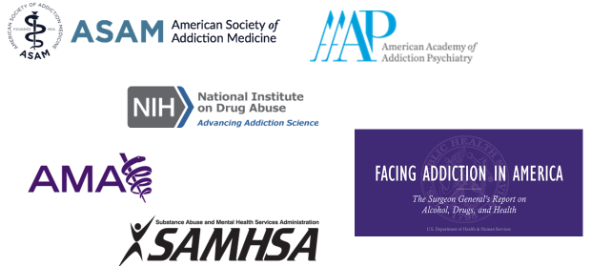
Medication Assisted treatment Options for Opioid Use Disorder
MAT is the gold standard of treatment for opioid use disorder… not Abstinence!
Every professional addiction society recommends using medications
Three medications FDA approved, all considered first line treatment
  Methadone
  Buprenorphine
  Naltrexone

Slide 29
MAT Comparison
Methadone
(Full Agonist)
Buprenorphine
(Partial Agonist)
Naltrexone
(Antagonist)
Pros:
Long lasting
Decades of evidence
Helps with pain
Cons:
Inconvenient
Possible diversion
Lethal in overdose
Withdrawal
Long half life
Stigma
Pros:
Doctor’s office
Minimal risk of overdose
Less risk of IV use
Helps with pain
Simple initiation
Cons:
Limited doctors who Rx
Possible diversion
Withdrawal
Stigma
Pros
Not diverted
No risk of overdose
No Dependency
Minimal stigma
Cons:
Compliance
No help with pain
Cost $$$
Cravings ?
Difficult Initiation

Slide 30
What happens if AN Overdose ViCTIm receives treatment with MAT?
Study of 17,568 survivors of a non-fatal opioid overdose from 2012-2014¹
Of those, only about 3 out of 10 received any kind of MAT
  Methadone: 2040 persons (11%) received for a median of 5 months
  Buprenorphine: 3022 persons (17%) received for a median of 4 months
  Naltrexone: 1099 persons (6%) received for a median of 1 month
All-cause mortality at 12 months of 4.7 deaths per 100 person years
Treatment with MAT was associated with mortality reduction of 53% with Methadone, 37% with Buprenorphine, and negligible for Naltrexone
¹Larochelle MR, Bernson D, Land T, et al. Medication for Opioid Use Disorder After Nonfatal Opioid Overdose and Association With Mortality: A Cohort Study. Ann Intern Med. 2018;169:137–145.. doi: 10.7326/M17-3107

Slide 31
Benefits of Starting Buprenorphine in the Emergency Department
INCREASED treatment follow up¹
INCREASED treatment retention
DECREASED days of illicit opioid use
DECREASED psychiatric admissions
Ultimate goals:
  Reduce Mortality & Morbidity!
  Increase their quality of life!
¹Dr. Gail D’Onofrino (https://medicine.yale.edu/edbup)

Slide 32
PHILOSOPHY OF USING MAT
Containment of the addiction, not cure
  What is “Cure” in any disease?
Using evidence base to guide treatment
Intervene early, stay connected
Protect society by treating the effected
Collaborate with the patient, help them guide treatment outcomes
NO Medication Miracles!
Multi-phasic
  Detox
  Recovery
Multi-dimensional
  Bio-psycho-social-spiritual illness
Multi-disciplinary
  Psychiatrist, PCP, etc.
  Therapist, clergy, etc.
  Physical therapy, dietician, trainer, etc.
  Law enforcement, Parole officers, Drug courts

Slide 33
Principles of Effective Medication Assisted Treatment
Using medications to treat opioid abuse is the gold standard of treatment
Taking medication as prescribed for opioid abuse = Sobriety
  Avoid chastising patients about being on ANY medication ➔ reinforces stigma, decreases rapport, and may increase the likelihood that they will not be engaged in their treatment
Maintaining on Buprenorphine or Methadone is always recommended in pregnancy to protect both the mother and her fetus
Not treating opioid addiction in prison = 129 times more likely to die of overdose in the two weeks following release¹➔ start treating during their incarceration
¹ Binswanger IA, Stern MF, Deyo RA, Heagerty PJ, Cheadle A, Elmore JG, et al. Release from prison--a high risk of death for former inmates. N Engl J Med. 2007;356(2):157–165. doi: 10.1056/NEJMsa064115.

Slide 34
Common Myths & Misconceptions

Slide 35
Common Myths
28 days, 90 days, or 180 days of residential treatment is the gold standard to treat opioid addiction
People are “cured” of addiction after a few months of sobriety
Addiction is not a disease, it is only a choice
It is easy to contract an infectious disease or overdose if you are exposed to drugs and/or drug paraphernalia
You will overdose if you are exposed to Fentanyl in anyway

Slide 36
There are Similar Risk Factors for HIV, Hepatitis B & C
Risk factor | HIV | HBV | HCV
Unprotected Sex | + | + | +*
Injection Drug Use | + | + | +
Tattoos, Piercings, Needlesticks | + | + | +
Hemodialysis | + | + | +
Transfusion/ Organ Transplant | + | + | +
Foodborne |  | +
Household contact |  | +
Institutionalized |  | +
Slide used with permission by Dr. Feinberg
*primarily among men who have sex with men

Slide 37
Risk of HIV BY Exposure
(treatment but no Cure)
HIV is a viral infection which if left untreated can advance to AIDS
If exposed, there is Post Exposure Prophylaxis (PEP) available to prevent conversion
Type of Exposure | Risk Per 10,000 Exposures | Percentage Risk
Blood transfusion | 9,250 | 92.5 %
Needle-Sharing During Injection Drug Use | 63 | 0.63 %
Accidental Needle-Stick | 23 | 0.23 %
Sex (varies) | 4 - 138 | 0.04 - 1.38 %
Biting, Spitting, Throwing Bodily Fluids | Negligible
CDC HIV Risk Behaviors
https://www.cdc.gov/hiv/risk/estimates/riskbehaviors.html

Slide 38
Hepatitis C
(Treatment & Cure)
Per CDC, for Persons Who Inject Drugs (PWID) in 2017 there was prevalence estimate of 53.1%, with a range of 38.1% to 68.0%.
Previous most common transmission was blood transfusions, now very rare with testing → IV use is the most common reason for transmission.
Needlestick transmission rates initially estimates at 1.8%, now believed to be 0.5%
15-25% of people clear it naturally, the other 75-85% become chronic carriers
Can lead to liver cirrhosis (10-20%) and hepatocellular carcinoma (1-5% annually)
No preventable vaccine but now there are effective curable treatments (8-12 weeks)
CDC: Hepatitis C Questions and Answers for Health Professionals
https://www.cdc.gov/hepatitis/hcv/hcvfaq.htm#section2

Slide 39
Hepatitis B
(Preventable)
Preventable vaccine given to all children (since 1992), booster available if exposed
Most likely viral infection to seroconvert, 10%+ of needlestick victims develop Hep B
Can survive outside of body for 7 days on a surface
90% of infants and 25%–50% of children aged 1–5 years will remain chronically infected with HBV where as 95% of adults recover completely from HBV infection and naturally clear it without becoming chronic carriers
IV drug use has increased rates of Hep B, most adults who die from it die from the acute infection
CDC: Hepatitis B Questions and Answers for Health Professionals
https://www.cdc.gov/hepatitis/hbv/hbvfaq.htm#treatment

Slide 40
Facts About Fentanyl
Fentanyl is about 50-100 times as potent as Morphine
Carfentanil (“Elephant Tranquilizer”) is 10,000 times as potent as Morphine
Ingesting small amounts of either can cause a fatal opioid overdose
Unless you get it in your mouth, directly inhale it, or it enters your bloodstream via injection the chances of overdose are very minimal
Very few cases of accidental exposures causing overdose (no police deaths in WV), more often it causes anxiety that it is misinterpreted as an overdose
A true overdose is treatable with Naloxone (will learn more about administering)

Slide 41
American College of Medical Toxicology (ACMT) Position Statement (2017)
“Fentanyl and its analogs are potent opioid receptor agonists, but the risk of clinically significant exposure to emergency responders is extremely low. To date, we have not seen reports of emergency responders developing signs or symptoms consistent with opioid toxicity from incidental contact with opioids. Incidental dermal absorption is unlikely to cause opioid toxicity. For routine handling of drug, nitrile gloves provide sufficient dermal protection. In exceptional circumstances where there are drug particles or droplets suspended in the air, an N95 respirator provides sufficient protection. Workers who may encounter fentanyl or fentanyl analogs should be trained to recognize the signs and symptoms of opioid intoxication, have naloxone readily available, and be trained to administer naloxone and provide active medical assistance. In the unlikely event of poisoning, naloxone should be administered to those with objective signs of hypoventilation or a depressed level of consciousness, and not for vague concerns such as dizziness or anxiety.”
Michael J. Moss , Brandon J. Warrick, Lewis S. Nelson, Charles A. McKay, Pierre-André Dubé , Sophie Gosselin , Robert B. Palmer & Andrew I. Stolbach (2017): ACMT and AACT position statement: preventing occupational fentanyl and fentanyl analog exposure to emergency responders, Clinical Toxicology, DOI: 10.1080/15563650.2017.1373782

Slide 42
Opioid Overdose
“Opioid Overdose Triad”
  Pinpoint pupils
  Unconsciousness
  Respiratory depression
Give Naloxone (Narcan) as many times as needed
Call EMS
Notes:
Users: always chasing the first high

Slide 43
Other common Misconceptions
Belief: Using medications to treat addiction is just “trading one drug for another”
Reality: Trading a drug that will kill them for a medication that will help keep them alive
Belief: Using medications is a crutch, you cannot “truly” recover until you stop everything
Reality: Some people need a crutch, we do not force diabetics to get off their insulin
Belief: No one gets better who struggles with addiction
Reality: With good supports and effective treatment, many do get better

Slide 44
Partnering With Law Enforcement to End this Opioid Epidemic
As doctors and healthcare providers, we cannot “force” anyone to undergo treatment
Law enforcement, with the backing of the judicial system, has to the power to compel patients to seek effective treatment
If patients are willing to get effective treatment, we should be willing to provide it
Working together we can be much more effective in treating the epidemic both in our state and on a national level
We need to use all available and effective treatment tools rather then put limits on what we can and cannot do to treat this disease of addiction

Slide 45
Summary
We are in the midst of a serious addiction epidemic that effects us all
Addiction is a fundamental neurological disease of our brain’s natural reward pathways
Addiction is a treatable disease with medications and other interventions
Medication assisted treatment with either methadone, buprenorphine, or naltrexone is the gold standard for treating opioid abuse, not abstinence
MAT has ample evidence to support its use, stigma is an enormous barrier to treatment
There are a lot of myths about substance use and treatment, separate fact from fiction
The risk of overdose is very low, infectious exposures are treatable /preventable
Healthcare and law enforcement can accomplish a lot more working together

Slide 46
? Questions ?
Always be prepared to give an answer to everyone who asks you to give the reason for the hope that you have. But do this with gentleness and respect…
1 Peter 3:15

Slide 47
Special Thanks
Dr. James Berry –Director of Addiction Services at WVU Medicine who is my mentor and has taught me most of what I know about addiction
Dr. Anita Stewart –who arranged this conference and who invited me to speak
All my patients who suffer from the horrible disease of addiction and who have allowed me to share in their tragedies and in their successes

Slide 48

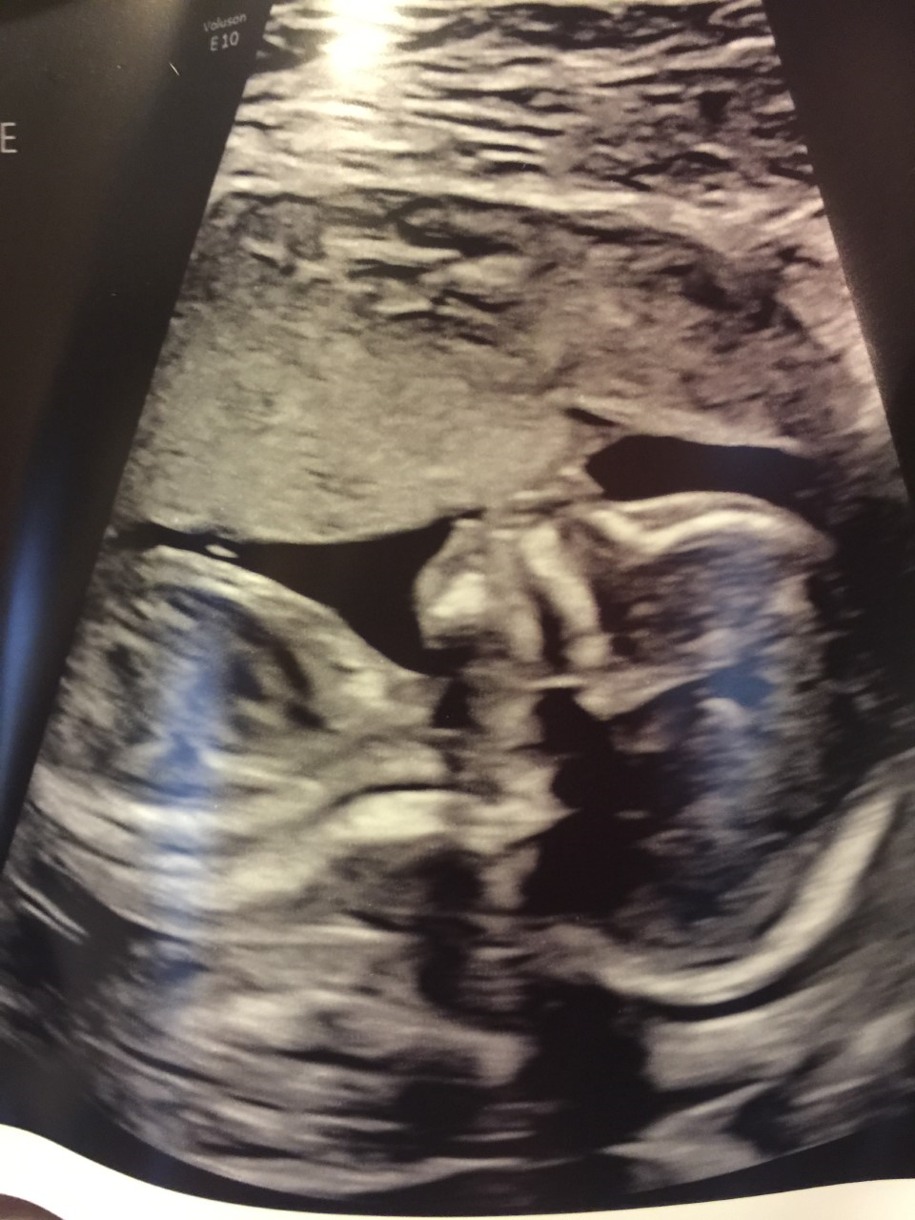
Thank You ALL !
Email: jhustead@hsc.wvu.edu
Phone: 724-630-4132 (cell)

