Slide 1
Supporting Recovery
Greg Perry
February 11, 2020

Slide 2
Working with communities to address the opioid crisis.
SAMHSA’s State Targeted Response Technical Assistance (STR-TA) Consortium assists STR grantees and other organizations, by providing the resources and technical assistance needed to address the opioid crisis.
Technical assistance is available to support the evidence-based prevention, treatment, and recovery of opioid use disorders.
Funding for this initiative was made possible (in part) by grant no. 6H79TI080816 from SAMHSA. The views expressed in written conference materials or publications and by speakers and moderators do not necessarily reflect the official policies of the Department of Health and Human Services; nor does mention of trade names, commercial practices, or organizations imply endorsement by the U.S. Government.
Notes:
More info on next slide

Slide 3
Working with communities to address the opioid crisis.
The STR-TA Consortium provides local, experienced consultants to communities and organizations to help address the opioid public health crisis.
The STR-TA Consortium accepts requests for education and training resources.
Each state/territory has a designated team, led by a regional Technology Transfer Specialist (TTS) who is an expert in implementing evidence-based practices.
Funding for this initiative was made possible (in part) by grant no. 6H79TI080816 from SAMHSA. The views expressed in written conference materials or publications and by speakers and moderators do not necessarily reflect the official policies of the Department of Health and Human Services; nor does mention of trade names, commercial practices, or organizations imply endorsement by the U.S. Government.

Slide 4
Contact the STR-TA Consortium
To ask questions or submit a technical assistance request:
    Visit www.opioidresponsenetwork.org
    Email str-ta@aaap.org
    Call 401-270-5900
Funding for this initiative was made possible (in part) by grant no. 6H79TI080816 from SAMHSA. The views expressed in written conference materials or publications and by speakers and moderators do not necessarily reflect the official policies of the Department of Health and Human Services; nor does mention of trade names, commercial practices, or organizations imply endorsement by the U.S. Government.

Slide 5
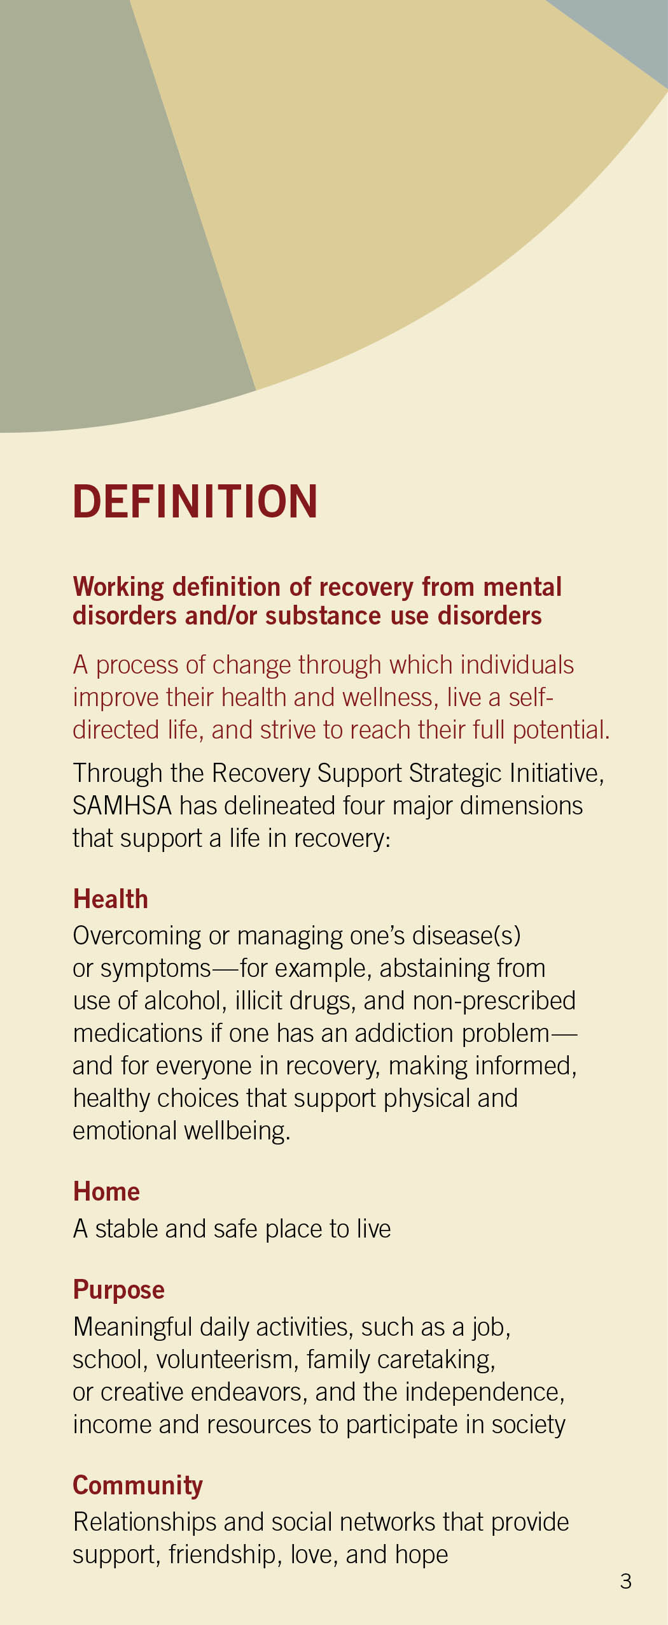

First, We Have To Define Recovery

Slide 6
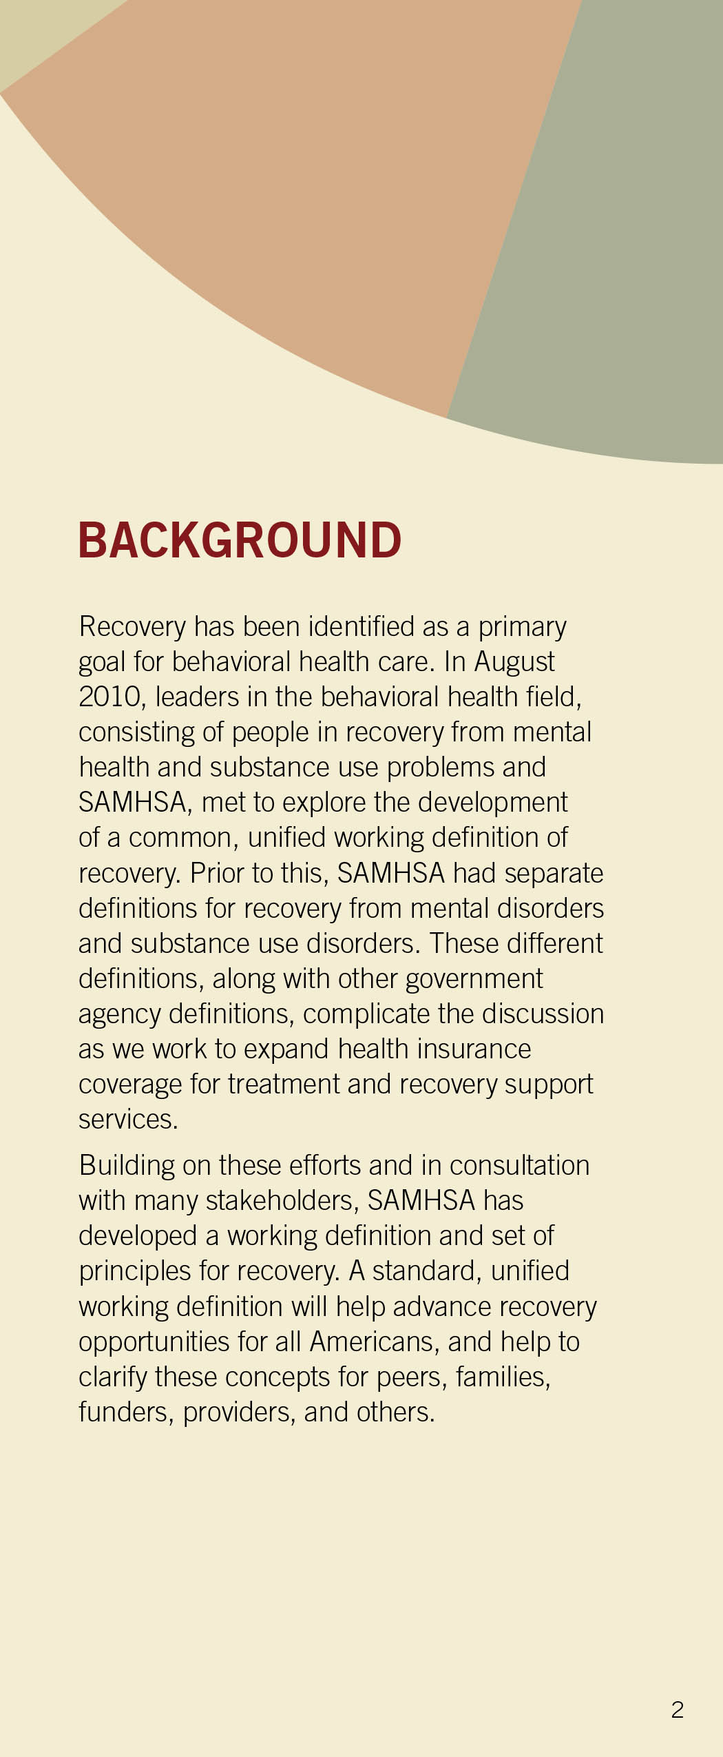
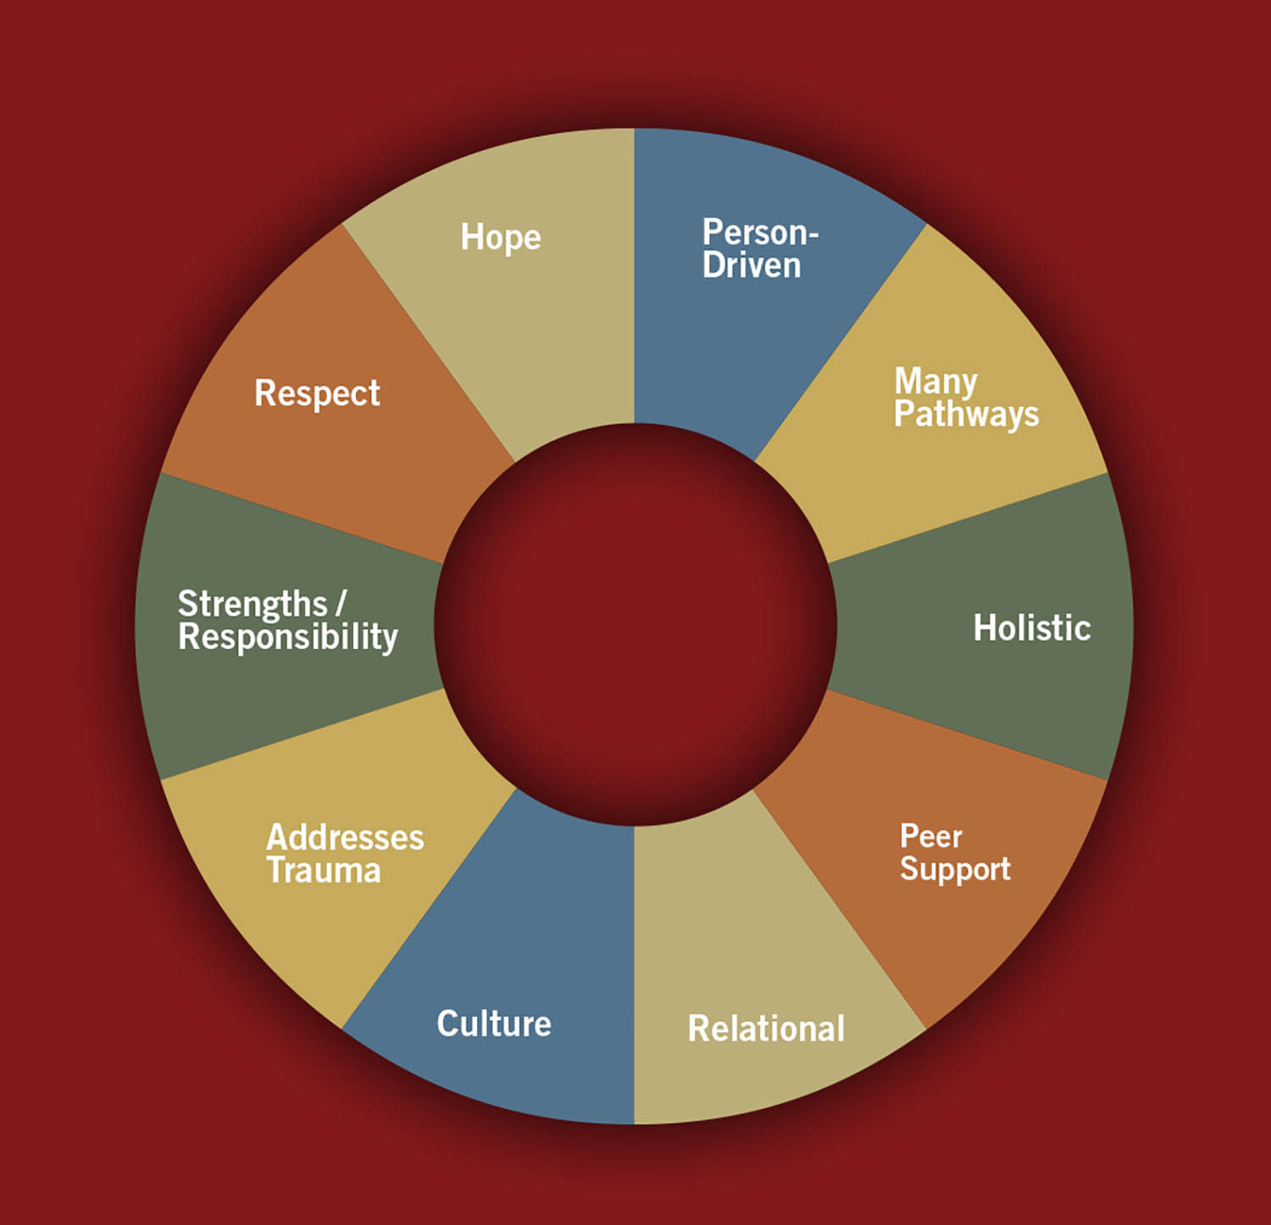
How That Definition Came To Be

Slide 7
All That Recovery Encompasses

Slide 8
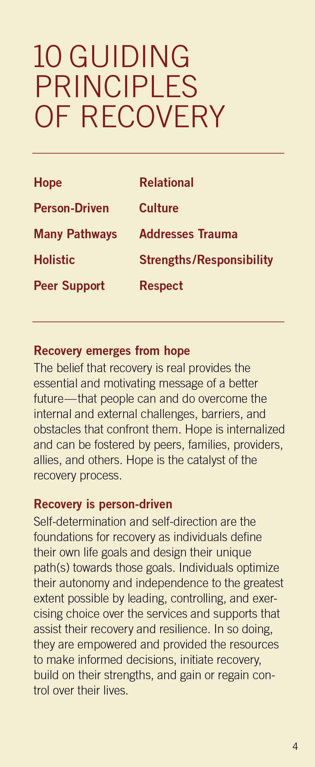
10 Principles

Slide 9
Hope

Slide 10
Person-Driven

Slide 11
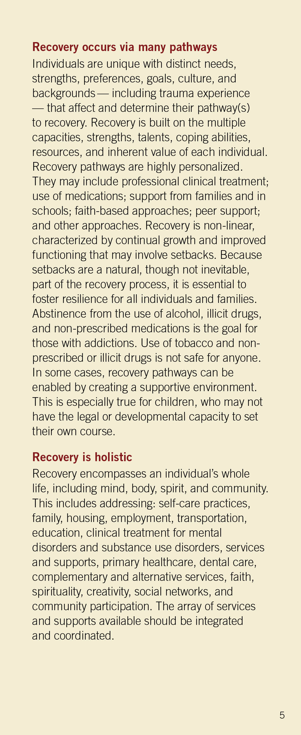
There Are Many Pathways

Slide 12
Holistic

Slide 13
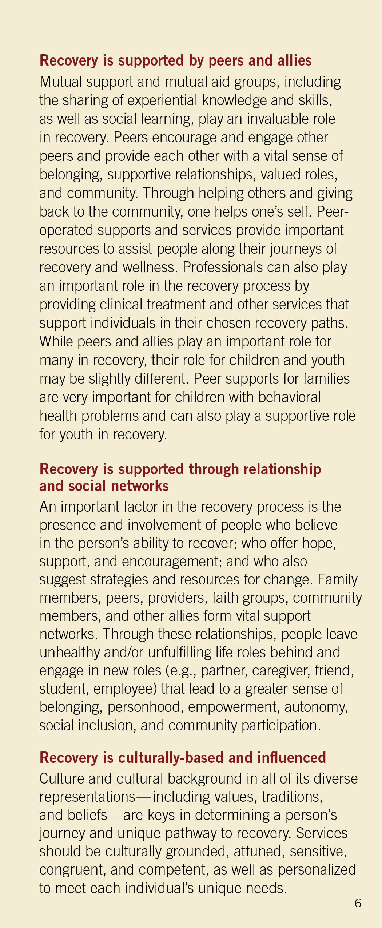
Who and How It Is Supported

Slide 14
Culturally-Based

Slide 15
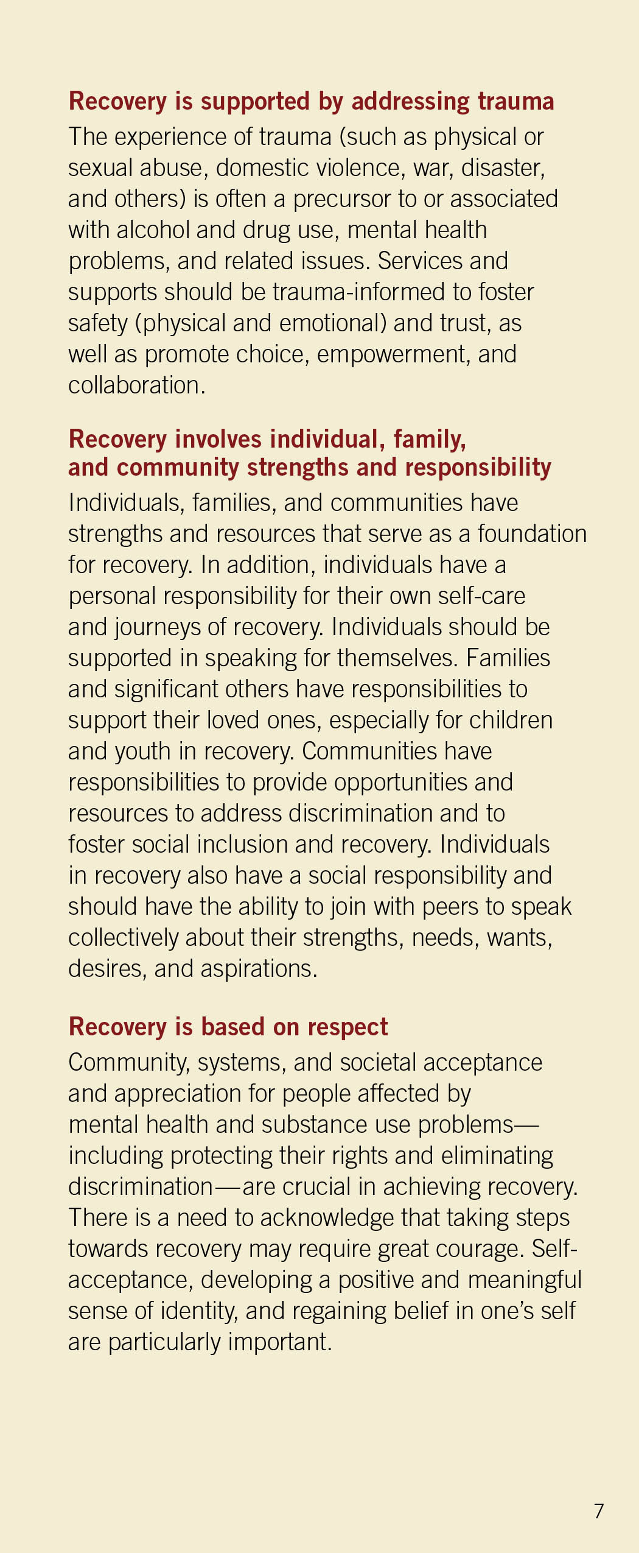
Trauma Must Be Addressed

Slide 16
Everybody Plays A Role

Slide 17
Respect Is Critical

Slide 18
Respect Is Critical

Slide 19
Core Competencies

Slide 20
What Are Core Competencies?
Core Competencies are the capacity to easily perform a role or function, in this case, to help others initiate and sustain their own personal recovery. They are often described as clusters of knowledge, skills, and attitudes a person needs to have in order to successfully perform a role or job or as the ability to integrate the necessary knowledge, skills, and attitudes. They have the potential to guide delivery of services and promote best practices.

Slide 21
Five Principles That Underlie Core Competencies
1. RECOVERY-ORIENTED:
By being recovery-oriented, people hold out hope to those they are serving, partnering with them to envision and achieve a meaningful and purposeful life. Supporters help those they serve identify and build on strengths and empower them to choose for themselves, recognizing that there are multiple pathways to recovery.
2. PERSON-CENTERED:
Support services are always directed by the person participating in the service. Support is personalized to align with the specific hopes, goals, and preferences of the individual served and to respond to specific needs the individual(s) has identified.

Slide 22
Five Principles That Underlie Core Competencies
3. VOLUNTARY:
Those who support people initiate or sustain their recovery are partners or consultants to those they serve. They do not dictate the types of services provided or the elements of recovery plans that will guide their work. Participation in recovery support services is always contingent upon choice.
4. RELATIONSHIP-FOCUSED:
The relationship between the behavioral health/peer worker and the peer is the foundation upon which recovery support services and support are provided. It is respectful, trusting, empathetic, collaborative, and mutual.

Slide 23
Five Principles That Underlie Core Competencies
5. TRAUMA-INFORMED:
Recovery support utilizes a strengths-based framework that emphasizes physical, psychological, and emotional safety and creates opportunities for survivors to rebuild a sense of control and empowerment.

Slide 24
The 12 Core Competencies

Slide 25
Engage in Collaborative and Caring Relationships:
1. Initiates contacts with people in recovery.
2. Listens to peers with careful attention to the content and emotion being communicated in the conversation.
3. Reaches out to engage peers across the whole continuum of the recovery process.
4. Demonstrates genuine acceptance and respect.
5. Demonstrates understanding of peers’ experiences and feelings.

Slide 26
CATEGORY I
Engage in Collaborative and Caring Relationships:
1. Initiates contacts with people in recovery.
2. Listens to peers with careful attention to the content and emotion being communicated in the conversation.
3. Reaches out to engage peers across the whole continuum of the recovery process.
4. Demonstrates genuine acceptance and respect.
5. Demonstrates understanding of peers’ experiences and feelings.

Slide 27
CATEGORY II
Provides Support:
1. Validates peers experiences and feelings.
2. Encourages the exploration and pursuit of community roles.
3. Conveys hope to peers about their own recovery.
4. Celebrates peers’ efforts and accomplishments.
5. Provides concrete assistance to help peers accomplish tasks and goals.

Slide 28
CATEGORY III
Shares Lived Experiences of Recovery:
1. Relates their own recovery stories, and with permission, the recovery stories of others in order to inspire hope.
2. Discusses ongoing personal efforts to enhance health, wellness, and recovery.
3. Recognizes when to share experiences and when to listen.
4. Describes personal recovery practices and helps peers discover recovery practices that work for them.

Slide 29
CATEGORY IV
Personalizes Support:
1. Understands his/her own personal values and culture and how these may contribute to biases, judgments, and beliefs.
2. Appreciates and respects the cultural and spiritual beliefs and practices of peers and their families.
3. Recognizes and responds to the complexities and uniqueness of each peer’.
4. Tailors services and support to meet the preferences and unique needs of peers and their families.

Slide 30
CATEGORY V
Supports Recovery Planning:
1. Assists and supports peers to set goals and to dream of future possibilities.
2. Proposes strategies to help a peer accomplish tasks or goals.
3. Supports peers to use decision-making strategies when choosing services and supports.
4. Helps peers to function as a member of their treatment/recovery support team.
5. Researches and identifies credible information and options from various resources.

Slide 31
CATEGORY VI
Links to Resources, Services, and Supports:
1. Develops and maintains up-to-date information about community resources and services.
2. Assists peers to investigate, select, and use needed and desired resources and services.
3. Helps peers to find and use health services and supports.
4. Accompanies peers to community activities and appointments when requested. (Advocate, advocate.)
5. Participates in community activities with peers when requested.

Slide 32
CATEGORY VII
Provides Information About Skills Related to Health, Wellness, and Recovery:
1. Educates peers about health, wellness, recovery and recovery supports.
2. Participates with peers in discovery or co-learning to enhance recovery experiences.
3. Coaches peers about how to access treatment and services and navigate systems of care.
4. Coaches peers in desired skills and strategies.
5. Educates family members and other supportive individuals about recovery and recovery supports.
6. Uses approaches that match the preferences and needs of peers.

Slide 33
CATEGORY VIII
Helps Peers to Manage Crises:
1. Recognizes signs of distress and threats to safety among peers and in their environments.
2. Provides reassurance to peers in distress.
3. Strives to create safe spaces when meeting with peers.
4. Takes action to address distress or a crisis by using knowledge of local resources, treatment, services and support preferences of peers.
5. Assists peers in developing advance directives and other crisis prevention tools.

Slide 34
CATEGORY IX
Values Communication:
1. Uses respectful, person-centered, recovery-oriented language in written and verbal interactions with peers, family members, community members.
2. Uses active listening skills.
3. Clarifies their understanding of information when in doubt of the meaning.
4. Conveys their point of view when working with colleagues.
5. Documents information as required by program policies and procedures.
6. Follows laws and rules concerning confidentiality and respects others’ rights for privacy.

Slide 35
CATEGORY X
Supports Collaboration and Teamwork:
1. Works together with other colleagues to enhance the provision of services and supports.
2. Assertively engages providers from mental health services, addiction services, and physical medicine to meet the needs of peers.
3. Coordinates efforts with health care providers to enhance the health and wellness of peers.
4. Coordinates efforts with peers’ family members and other natural supports.
5. Partners with community members and organizations to strengthen opportunities for peers.
6. Strives to resolve conflicts in relationships with peers and others in their support network.

Slide 36
CATEGORY XI
Promotes Leadership and Advocacy:
1. Uses knowledge of relevant rights and laws (HIPAA, ADA, etc.) to ensure that peers’ rights are respected.
2. Advocates for the needs and desires of peers in treatment team meetings, community services, living situations, and with family.
3. Uses knowledge of legal resources and advocacy organizations to build an advocacy plan.
4. Participates in efforts to eliminate prejudice and discrimination (aka stigma) of people who have behavioral health conditions and their families.
5. Educates colleagues about the process of recovery and the use of supports.
6. Actively participates in efforts to improve the organization.
7. Maintains a positive reputation in peer/professional communities.

Slide 37
CATEGORY XII
Promotes Growth and Development:
1. Recognizes the limits of their knowledge and seeks assistance from others when needed. (Stay In Your Lane.)
2. Uses supervision (mentoring, reflection) effectively by monitoring self and relationships, preparing for meetings and engaging in problem-solving strategies with the supervisor (mentor, peer).
3. Reflects and examines own personal motivations, judgments, and feelings that may be activated by the peer work, recognizing signs of distress, and knowing when to seek support.
4. Seeks opportunities to increase knowledge and skills of peer support.

Slide 38
Small Group Discussion

Slide 39
CATEGORY XII
DISCUSS AND LIST:
Where is your community with regards to these types of supports/domains?
Look for areas that are completely missing and/or need improvement.
What will it take to implement these?
Is the infrastructure there (behavioral health capacity, social capacity) to bring in these forms of support (strengths vs weaknesses)?

Slide 40
Large Group Discussion

Slide 41
Q&A

Slide 42
References
Core Competencies for Peer Workers in Behavioral Health Services. www.samhsa.gov/sites/default/files/programs_campaigns/brss_tacs/core-competencies.pdf .
SAMHSA’s Working Definition of Recovery https://store.samhsa.gov/system/files/pep12-recdef.pdf .
Notes:
.

