Slide 1

Vicarious Trauma and Compassion Fatigue for Law Enforcement
Randy Ferrill, BA
FAST Program coordinator
Notes:
Welcome
Introductions
How do you take care of others?
Housekeeping
No breaks but feel free to make yourself comfortable

Slide 2

“The expectation that we can be immersed in suffering and loss daily and not be touched by it is as unrealistic as expecting to be able to walk through water without getting wet”
(Remen, 2006, as cited in Office for Victims of Crime [OVC], n.d.)

Slide 3
Definition of Terms
Stress
  Acute
  Chronic
Traumatic Stress
Vicarious Trauma
Vicarious Traumatization
Secondary Traumatic Stress
Compassion Fatigue
Burnout

Slide 4
Stress
Stress is defined as a state of mental or emotional strain or tension resulting from adverse or very demanding circumstances
Stress can be acute or chronic
  Acute: Short duration but typically severe
  Chronic: Persisting for a long time or constantly recurring
  (Oxford, 2020)

Slide 5
Examples of Acute/Chronic Stress
Acute
Chronic
A fight with a loved one
Car accidents
A presentation
Poverty
An unhappy marriage
Dangerous work environment

Slide 6
Traumatic Stress
When acute stress events are shocking and emotionally overwhelming, they may be described as traumatic (International Society for Traumatic Stress Studies [ISTSS], 2020)
Traumatic events may involve actual or threat of death, serious injury, or threat to physical integrity
Reactions to traumatic events varies for the individual and can range from mild disruptions in regular life or severe and debilitation, i.e. Posttraumatic Stress Disorder

Slide 7
Categories of Traumatic Stress
Human: War; Homicide; Physical, Emotional, or Sexual Abuse; Child Abuse; Grief and Loss; Witnessing Violence; Sexual/Physical Assault;
Natural: Hurricane; Earthquake; Flood; Fire
On the Job: Fight or physical attack; Threat of physical harm; Accident
An event can be traumatic if it involves a real or perceived threat one’s physical or emotional well-being, it is overwhelming, results in intense feelings of fear or lack of control, leaves one feeling helpless, and changes the way one understands the world (American Psychiatric Association [APA], 2000)

Slide 8
Exposure to Trauma in the Workplace
As law enforcement officers, individuals are often exposed to trauma, both directly and indirectly, which puts the individual at risk for different trauma responses
  Direct: Post Traumatic Stress Disorder (PTSD), Post Traumatic Stress Symptoms
  Indirect: PTSD, Post Traumatic Stress Symptoms, Secondary Traumatic Stress Symptoms, Vicarious Traumatization, Compassion Fatigue (OVC, n.d.)

Slide 9
What is Vicarious Trauma?
Vicarious trauma is defined as “an occupational challenge for people working and volunteering in the fields of victim services, law enforcement, emergency medical services, fire services, and other allied professions, due to their continuous exposure to victims of trauma and violence” (OVC, n.d.)
Vicarious trauma is also sometimes referred to as secondary trauma.
Notes:
Affects how we feel with our work environment, client environment and personal environment

Slide 10
Traumatic Stress vs. Vicarious Traumatization
Traumatic Stress
Vicarious Traumatization
Extreme emotionality or absence of emotion
Exaggerated startle response
Flashbacks, Nigtmares
Overly involved with or avoidance of the victim/survivor of traumatic stress
Hypervigilance
Intrusive thoughts and images, or nightmares from the victims’ description of traumatic event (OVC, n.d.)

Slide 11
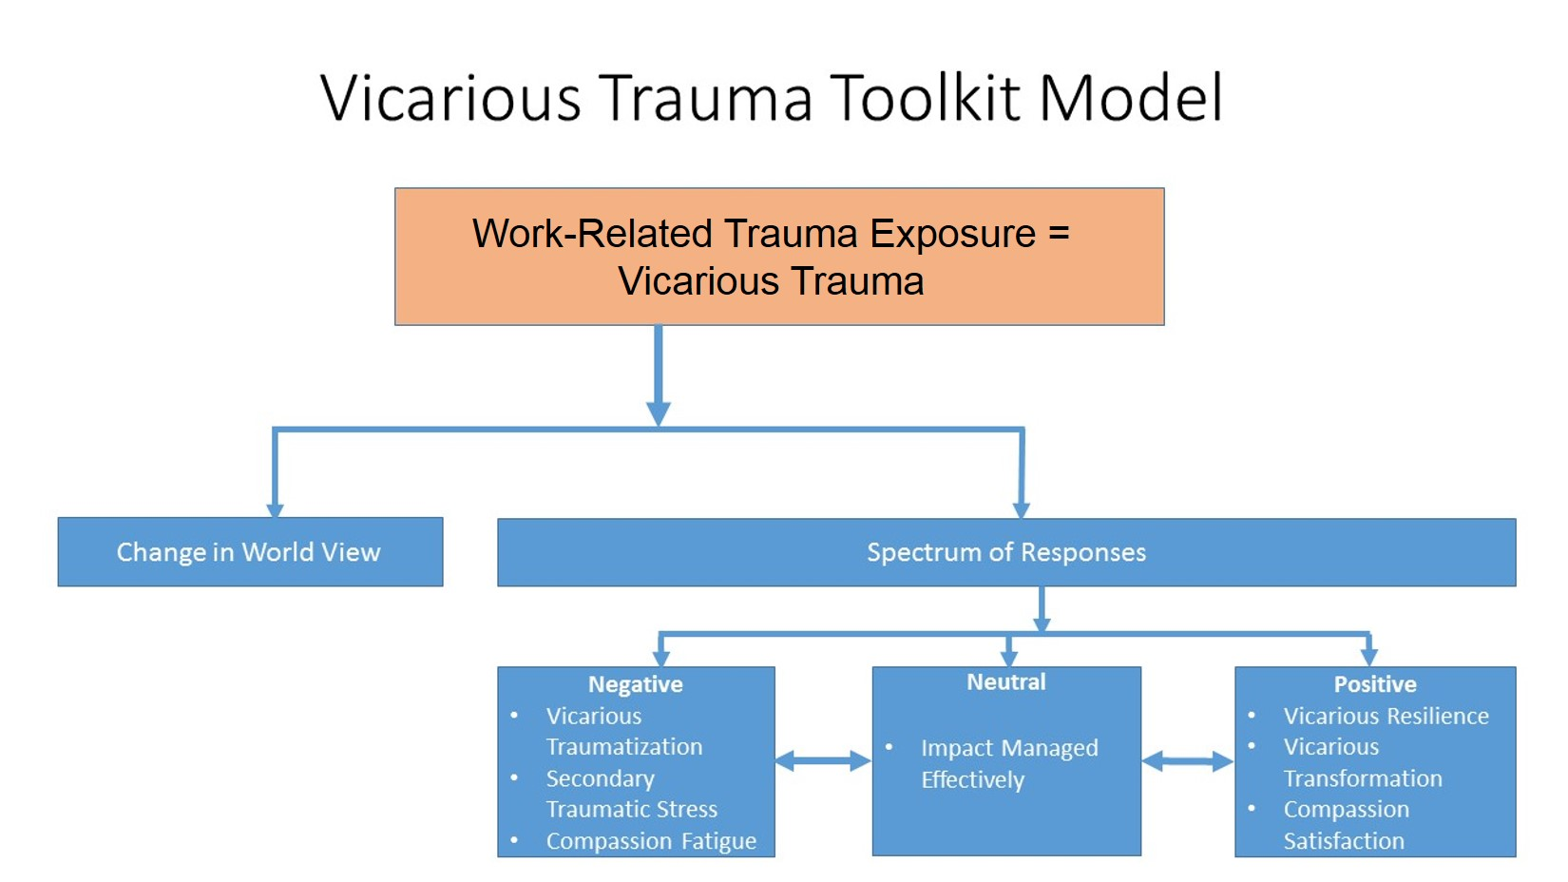

Slide 12
Vicarious Traumatization Among Law Enforcement
OVC (n.d.) reports that 40-80 percent of helping professionals experience high rates of vicarious traumatization
Vicarious Traumatization affects the individual in all areas of life: physical, emotional, behavioral, spiritual, cognitive, and relational
Professional impacts of Vicarious Traumatization include
  Performance: Decrease in quality of work, Task avoidance
  Morale: Apathy, Reduced compassion, Dissatisfaction
  Relational: Intolerance of others, Poor communication, Impatience

Slide 13
Compassion Fatigue→Burnout
Compassion fatigue can be developed by helping those in distress and is an extreme state of tension and preoccupation with the suffering of those being helped to the degree that it can create vicarious traumatization for the helper (Compassion Fatigue Awareness Project, 2017)
Compassion fatigue is the result of chronic stress from caring for others.
Experiencing compassion fatigue can lead to burnout, a state of physical, emotional, and mental exhaustion caused by long-term involvement in emotionally demanding situations, characterized by depression, cynicism, boredom, loss of compassion, and discouragement (Pines & Aronson, 1988, as cited by OVC, n.d.)

Slide 14
Increased Risk Factors
Personal
Professional
Trauma History
Pre-existing psychological disorder
Young age
Isolation, inadequate support system
Loss in last 12 months
Lack of quality supervision
High percentage of trauma survivors in caseload
Little experience
Worker/organization mismatch
Lack of professional support system
Inadequate orientation and training for role (OVC, n.d.)

Slide 15
Professional Quality of Life Scale (PROQOL)
Can be found at http://www.proqol.org/ProQol_Test.html
Measures positive and negative aspects of helping others who have trauma
Subscales for compassion satisfaction, burnout and compassion fatigue
Can be used at regular intervals to track changes or when interventions are utilized.
Notes:
Screener for stress-related health problems
Not a medical or psychological assessment
Self report for the past 30 days
**Keep score sheets until later in session

Slide 16
Prevention Strategies
Psychoeducation
Clinical supervision
Skills training
Self-care groups in the workplace
Flextime
Buddy system
Use of evidence based practices
  Taken from the National Child Traumatic Stress Network
Notes:
Today!! Learning about trauma and self care
Additional supervision
Use of flextime or PTO when needed and possible

Slide 17
Intervention Strategies
Cognitive behavioral interventions
Mindfulness training
Reflective supervision
Adjustment of caseload
Referral to Employee Assistance Programs (EAP) or outside agencies
National Child Traumatic Stress Network (2017)
Notes:
Mindfulness-being in the present—identify thoughts and feelings without judging them
Reflective supervision—examine thoughts and feelings while using awareness to help client
Caseload--As appropriate with discussion from supervisors
Sometimes we put ourselves out to clients, work, family, life, we forget that we need self care
More roles=more responsibilities

Slide 18
Resilience in the Face of Trauma
Resilience is defined as the process of adapting well in the face of adversity, trauma, tragedy, threats, or even significant sources of stress (OVC, n.d.).
Resilience can decrease the likelihood of developing compassion fatigue, vicarious traumatization, and burnout.

Slide 19

Vicarious Resilience
Helping others does not always lead to negative consequences. Vicarious resilience can be developed, the process of learning about overcoming adversity from the trauma survivor (OVC, n.d.).

Slide 20

Impact of Vicarious Resilience
Greater perspective of own problems
More optimistic
Increased sense of hope, understanding, and belief in the possibility of recovery from traumatic events
Sense of commitment to and finding meaning in work
(OVC, n.d.)

Slide 21
“First responders bear witness to damaging and cruel treatment experienced by others, shattering any assumptions of invulnerability.” (Janoff-Bulman, 1992, as cited by OVC, n.d.)

Slide 22
ProQoL Scoring
Compassion Satisfaction
Add up the numbers
Burnout
Some numbers are reversed (if they have a *)
Add up the numbers
Secondary Traumatic Stress
Add up numbers
Notes:
Average scores are 50
Second page describes satisfaction/burnout/STS
Discussion

Slide 23
References
Compassion Fatigue Awareness Project (2017). What is Compassion Fatigue? Retrieved March 9, 2020, from https://www.compassionfatigue.org/pages/compassionfatigu e.html
International Society for Traumatic Stress Studies (2020). What is Traumatic Stress? Retrieved March 9, 2020, from https://istss.org/public-resources/what-is-traumatic-stress
Office for Victims of Crime (n.d.). Introduction to Vicarious Trauma for Law Enforcement. Retrieved March 9, 2020, from https://vtt.ovc.ojp.gov/ojpasset/Documents/VT_Intro_to_VT_f or_Law%20Enforcement-508.pdf
Notes:
Questions

Slide 24
Contact Information
Randy Ferrill rferrill@fmrs.org
(304) 256-7100
(304) 890-2626

