Slide 1
Straight Talk About Stigma
Steven Samra & Greg Perry
November 12, 2019

Slide 2
Working with communities to address the opioid crisis.
SAMHSA’s State Targeted Response Technical Assistance (STR-TA) Consortium assists STR grantees and other organizations, by providing the resources and technical assistance needed to address the opioid crisis.
Technical assistance is available to support the evidence-based prevention, treatment, and recovery of opioid use disorders.
Funding for this initiative was made possible (in part) by grant no. 6H79TI080816 from SAMHSA. The views expressed in written conference materials or publications and by speakers and moderators do not necessarily reflect the official policies of the Department of Health and Human Services; nor does mention of trade names, commercial practices, or organizations imply endorsement by the U.S. Government.
Notes:
More info on next slide

Slide 3
Working with communities to address the opioid crisis.
The STR-TA Consortium provides local, experienced consultants to communities and organizations to help address the opioid public health crisis.
The STR-TA Consortium accepts requests for education and training resources.
Each state/territory has a designated team, led by a regional Technology Transfer Specialist (TTS) who is an expert in implementing evidence-based practices.
Funding for this initiative was made possible (in part) by grant no. 6H79TI080816 from SAMHSA. The views expressed in written conference materials or publications and by speakers and moderators do not necessarily reflect the official policies of the Department of Health and Human Services; nor does mention of trade names, commercial practices, or organizations imply endorsement by the U.S. Government.

Slide 4
Contact the STR-TA Consortium
To ask questions or submit a technical assistance request:
    Visit www.opioidresponsenetwork.org
    Email str-ta@aaap.org
    Call 401-270-5900
Funding for this initiative was made possible (in part) by grant no. 6H79TI080816 from SAMHSA. The views expressed in written conference materials or publications and by speakers and moderators do not necessarily reflect the official policies of the Department of Health and Human Services; nor does mention of trade names, commercial practices, or organizations imply endorsement by the U.S. Government.

Slide 5
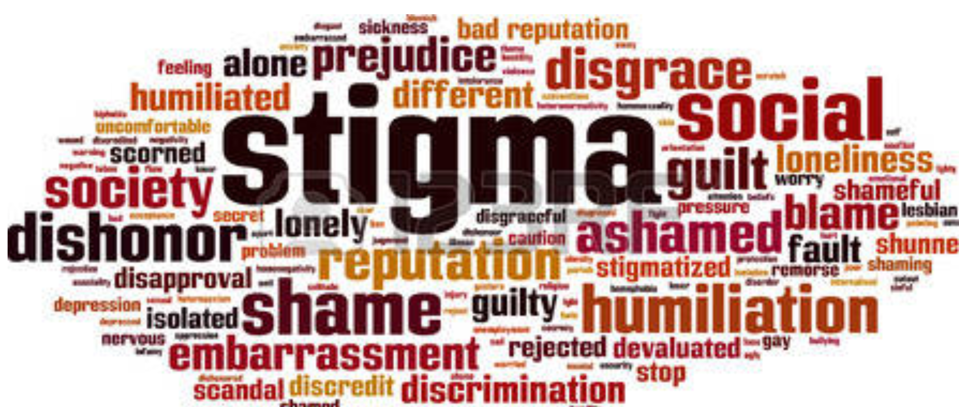
We’re Swimming In Stigma
Stigma is defined as a mark of disgrace or infamy, a stain of reproach, as on one's reputation (SAMHSA, 2018)
Stigma remains the biggest barrier to addiction treatment faced by patients/clients (naabt.org)
Notes:
(The National Alliance of Advocates for Buprenorphine Treatment )
DON’T read the slide
Samhsa’s definition for Stigma is a mark of disgrace or infamy, a stain or reproach, as on one's reputation, and refers to attitudes and beliefs that lead people to reject, avoid, or fear those they perceive as being different.”
Stigma remains the biggest barrier to addiction treatment faced by patients/clients (naabt.org) and the terminology used to describe addiction has contributed to the stigma. Substance use disorders carry a high burden of stigma, so if you want folks to get into treatment…. Jis sayin here, folks.
Just the, fear of judgment alone means that people with substance use disorders are less likely to seek help, and more likely to drop out of treatment programs in which they do enroll.
Lots of derogatory, stigmatizing terms were popular and used throughout the “War on Drugs” in an effort to dissuade people from misusing substances. Education took a backseat, mainly because little was known about the science of addiction.
Changing the language reduces the stigma and will benefit everyone. It will allow patients to more easily regain their self esteem, allow lawmakers to appropriate funding, allow doctors to treat without disapproval of their peers, allow insurers to cover treatment, and help the public understand this is a medical condition as real as any other” (naabt.org). The National Alliance of Advocates for Buprenorphine Treatment
Many of us are already focusing on stigma reduction through person first language. We’ll talk more about this shortly, and there are some good resources available online as well.

Slide 6
3 Types of Stigma
“Public stigma” encompasses the attitudes and feelings expressed by many in the general public toward persons living with mental health or SUD challenges or their family members.
“Institutional stigma” occurs when negative attitudes and behaviors about mental illness or SUD, including social, emotional, and behavioral problems, are incorporated into the policies, practices, and cultures of organizations and social systems, such as education, health care, and employment.
“Self-stigma” occurs when individuals internalize the disrespectful images that society, a community, or a peer group perpetuate, which may lead many individuals to refrain from seeking treatment for their mental health or SUD conditions.”
Notes:
DON’T read the slide
There are 3 types of stigma (actually 4, but these are the primary ones): public, institutional and self stigma
Public stigma – memes and signs that suggest moral failures, comments in print and online media, using images of ppl overdosed in their cars, etc.
Institutional stigma - Usually the bias targets specific, easily stereotyped and generalizable attributes, such as race, gender, nationality, sexual orientation and age. Though direct discrimination is illegal by United States law, many believe that indirect discrimination is still pervasive in many social institutions and daily social practices. The recent transgender ban in the military is an example.
Self stigma’’s big take away here is both that this type of stigma may keep people from seeking services for their mh or sud challenges, AND it also causes a loss of hope, self esteem and confidence, creating a vicious circle of coping with substance misuse to combat the pain of the stigma, which leads to ever more self stigma and substance misuse or an exacerbation of mh problems.

Slide 7
How Does Stigma Affect Family Members & Others?
This is called courtesy stigma. It means sometimes family members & those associated with persons with mental illness or SUD experience avoidance by others because of stigma.
Some say mental health and addiction services receive less funding because of the type of service they provide, and there is often less support money.
Communities lose the positive resources those with mental illness/SUD could provide. Stigma perpetuates fears about mental illness and addiction.
Notes:
READ the slide
Cadca conference and world café session re SUD docs in str talking about the stigma within their med community for specializing in addiction.

Slide 8
The Backbone of Stigma
Lack of trust in intimate settings
Possible contact with vulnerable group
Potential for self harm
MI/SUD being antithetical to power or authority
Unsure how to interact with person with MI/SUD
Source: https://www.ncbi.nlm.nih.gov/books/NBK384923/
Notes:
Don’t read slide yet:
In the 2006 Global Context Study , levels of recognition, acceptance of neurobiological causes of mental illness and substance use, and treatment endorsement were similarly high; however, a core of five prejudice items persisted, and these are considered the backbone of stigma.
The persistence of core prejudice factors help explain why increased public knowledge has not decreased public stigma.. So what are those 5 backbones of stigma? READ the Slide
Lack of trust in intimate settings – do you want cousin John, who has the severe crack addiction, in the same room with Grandma’s pocketbook?
Possible contact with vulnerable group – Do you want John in the same room as Grandma? Or with a vulnerable child? Or your 14 year old daughter or granddaughter?
Potential for self harm – who do I call when my new renter John lights his hair on fire at 3 in the morning?
MI/SUD being opposed to power or authority – if we tell John he needs to leave, will he obey, or will he turn violent? Or goes quiet, or just ignores you?
Unsure how to interact with person with MI/SUD – What do I even say, and worse, what do I do if things get weird or scary?

Slide 9
Stigma Roulette For SUD
Stigma from within
  Blame self, feel hopeless
Stigma from recovery community
  Medications vs. “abstinence”
Stigma from clinicians
  Belief that treatment is ineffective
Stigma from outside
  Choice (moral failing) vs. disease
Notes:
Don’t read the slide
People with addiction face many different types of stigma. They face stigma from within– they may blame themselves or feel hopeless.
They can face stigma even within the recovery community. This is particularly true for people on medication treatments for their illness. So while we would never shame someone with diabetes for being on insulin, people with addiction who are on lifesaving medications are often shamed.
They can face stigma from the people who are supposed to be treating them., There is a long held belief in pockets of the medical system and among some clinicians that treatment is ineffective or that people don’t get better.
Finally, ppl with addictions face huge stigma from the general public, who see it as a moral failing because they erroneously believe that addiction is a choice not a disease.

Slide 10
How does Stigma Impact Individuals?
Effects of Prejudice and Discrimination
Prejudice and discrimination exclude people with MH and SUD challenges from activities that are open to other people | This limits people’s ability to: Get/keep employment Get/keep housing Get health care (including MH/SUD TX) Be accepted by family/friends Find/make friends or have other long-term relationships Take part in social activities
Prejudice and discrimination often become internalized by people with MH/SUD challenges | This leads them to: Believe the negative things (self stigma) Have lower self esteem because of guilt/shame
Prejudice and discrimination can cause ppl with MH/SUD challenges to keep it a secret | As a result: They avoid getting the help they need MH/SUD issues less likely to decrease or end
(Corrigan P., Watson, A., (2002) Understanding the impact of stigma on people with mental illness. World Psychiatry, 1 (1):16-20)
Notes:
So how does stigma actually impact people?
Read the slide

Slide 11
Factors that Influence Stigma and Consequences
Blame
People with substance use disorders are generally considered to be more responsible for their conditions than people with depression, schizophrenia, or other psychiatric disorders (Crisp et al., 2000, 2005; Lloyd, 2013; Schomerus et al., 2011).
Belief that a substance misuser's illness is a result of the person's own behavior can also influence attitudes about the value and appropriateness of publicly funded alcohol and drug treatment and services (Olsen et al., 2003).
(SAMHSA, 2018)
Notes:
Read the slide

Slide 12
More Consequences of Stigma
Substance use disorder is among the most stigmatized conditions in the US and around the world. People do not want to work with, be related to, or even see people with a substance use disorder in public.
Many believe that people with a substance use disorder can or should be denied housing, employment, social services, and health care.
Some health care providers treat patients who have substance use disorders differently.
Clinicians have lower expectations for health outcomes for patients with substance use disorders; this in turn can affect whether the provider believes the patient is deserving of treatment.
Some health care providers, falsely believing that substance use disorders are within a person’s control, cite feelings of frustration and resentment when treating patients with substance use disorders
https://www.samhsa.gov/capt/sites/default/files/resources/sud-stigma-tool.pdf
Notes:
Read the slide
In a recent study of Americans conducted by Johns Hopkins University, only 22% of people surveyed were willing to work closely with someone suffering from drug addiction, yet 62% were willing to work closely with someone suffering from mental illness.

Slide 13
Stereotypes of Dangerousness
  People with substance use disorders are considered even more dangerous and unpredictable than those with schizophrenia or depression (Schomerus et al., 2011).
  In a survey conducted in the United States (Link et al., 1997), a vast majority of respondents considered it likely for a cocaine- or alcohol-dependent person to hurt others.
Notes:
Read the slide
And this isn’t just for the SUD community; think about what is typically said whenever there is a mass or workplace shooting about the shooter. Almost ALWAYS very quickly begins to comment on the person’s “mental health.”

Slide 14
Media Portrayals
Much of the evidence on the media's influence on stigma change is negative in direction (Pugh et al., 2015).
The media play a crucial role in stoking fear and intensifying the perceived dangers of persons with substance use disorders (Lloyd, 2013).
Similarly, media portrayals of people with mental illness are often violent, which promotes associations of mental illness with dangerousness and crime (Diefenbach and West, 2007; Klin and Lemish, 2008; Wahl et al., 2002).
Furthermore, the media often depict treatment as unhelpful (Sartorius et al., 2010; Schulze, 2007) and portray pessimistic views of illness management and the possibility of recovery (Schulze, 2007).
Notes:
Read the slide
Another content analysis in 2004 of U.S. news coverage of mental health issues found that, in 39 percent of stories, an association was made between persons with mental illness and dangerousness (Corrigan et al., 2005a). Treatment was mentioned in 26 percent of stories but only 16 percent of the stories included recovery as an outcome.
Not so Fun Fact: Results from the 2006 General Social Survey found an increase in the public's knowledge of mental disorders and treatment since their previous 1996 survey, but stigma levels for people with mental illness did not decrease over that time (Pescosolido et al., 2010). This tells us that it requires more than just knowledge about the disorders and treatment for them. Language matters!

Slide 15
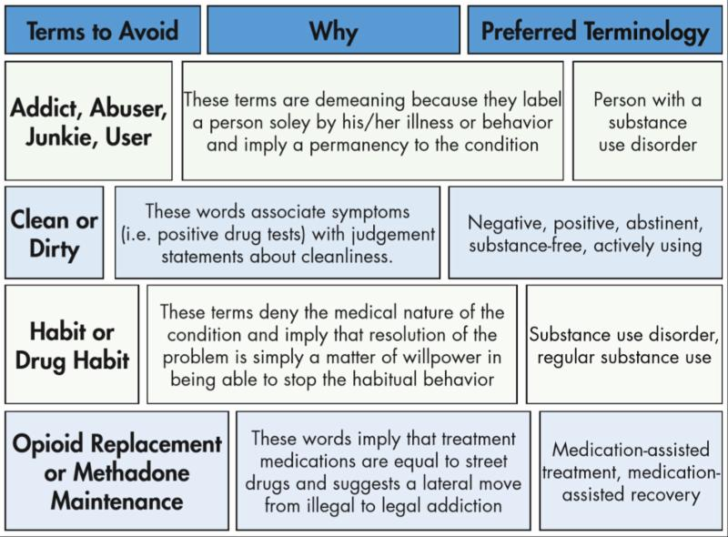
Stigma = Prejudice = Discrimination
Notes:
Don’t read the slide
Words matter, folks. This is just a small example of of person first and appropriate language to use to combat stigma and prejudice. There are a number of good resources available for download to get a better grasp of person first language and I’ve included the links to two very quick and easy examples on the next slide.

Slide 16
Additional Person First Language Examples
Describing People With Disabilities: https://www.mha-em.org/images/documents/people_first_language-txcdd.pdf
The Words We Use Matter - Reducing Stigma through Language: http://www.naabt.org/documents/NAABT_Language.pdf
Notes:
We’ve listed these two docs here and where you can find them on the web, but you also have these both as handouts, too.

Slide 17
Role of Providers/Policy Makers
Reduce stigma surrounding substance misuse.
Challenge providers and communities to be aware of unintentional bias.
Use appropriate language in formal and informal conversations when discussing SUDs to decrease stigma by:
      Removing labels
      Using “person first” language
Notes:
Read the slide
Let me just say a quick word about the unintentional or “unconscious bias”
Many researchers suggest that unconscious bias occurs automatically as the brain makes quick judgments based on past experiences and background. As a result of unconscious biases, certain people benefit and other people are penalized.
Two quick examples to help us quickly understand this:
Resumes are a pretty consistent source of unconscious bias. One particular study gave a group of managers a set of resumes. Some of them were exact duplicates where only the names had been changed. Resumes with the Anglo sounding names received substantially more callbacks that those with diverse names of other origins.
Need help programming your smart phone? The best choice is a Generation Y-er or your child, not the Baby Boomer, right? This could be an accurate assumption, but it’s not always the case.

Slide 18
Reminders
  Substance Use Disorder (SUD) is a chronic disease. . . as are diabetes, depression and hypertension
  Substance use falls along a continuum
    Use ranges from abstinence/low-risk to chronic dependence and encompasses all stages in between
    Relapse and lapse are a part of the disease process
  As many other chronic diseases can be managed, SUD can also be managed through appropriate treatment -- even during pregnancy
  Successful treatment for SUD means the person is in recovery; it does not mean they are “cured”
Notes:
Read just the intros to each thing on the slide (2 more reminder slides are coming)
Remember too that “There are 2 main factors that influence stigma: cause and controllability. Stigma decreases when people perceive that the individual is not responsible for causing his/her problem and when he or she is unable to control it.” Education and changing terminology used will influence perceptions.
Source. Kelly, J.F., Walkerman, S.E., & Saitz, R. (2015, January). Stop talking 'dirty': clinicians, language, and quality of care for the leading cause of preventable death in the United States. The American Journal of Medicine, 128(1), 8-9.
Source: Buchman, D.Z., Leece, P., & Orkin, A. (2017, Winter). The epidemic as stigma: the bioethics of opioids. Journal of Law, Medicine, & Ethics, 45(4), 607-611.

Slide 19
Reminders (continued)
  Embrace positive change: Treatment for substance use disorders has historically been viewed as binary, with addiction and abstinence as a person’s only two options
    Don’t create a dichotomy of “someone is using or not using.” There are many positive changes a person can make to reduce negative consequences
    Don’t convey the impression that abstinence is the only goal
    Don’t assume there is only one “right” way to address substance misuse
Notes:
Read the slide
Source. Kelly, J.F., Walkerman, S.E., & Saitz, R. (2015, January). Stop talking 'dirty': clinicians, language, and quality of care for the leading cause of preventable death in the United States. The American Journal of Medicine, 128(1), 8-9.
Source: Buchman, D.Z., Leece, P., & Orkin, A. (2017, Winter). The epidemic as stigma: the bioethics of opioids. Journal of Law, Medicine, & Ethics, 45(4), 607-611.

Slide 20
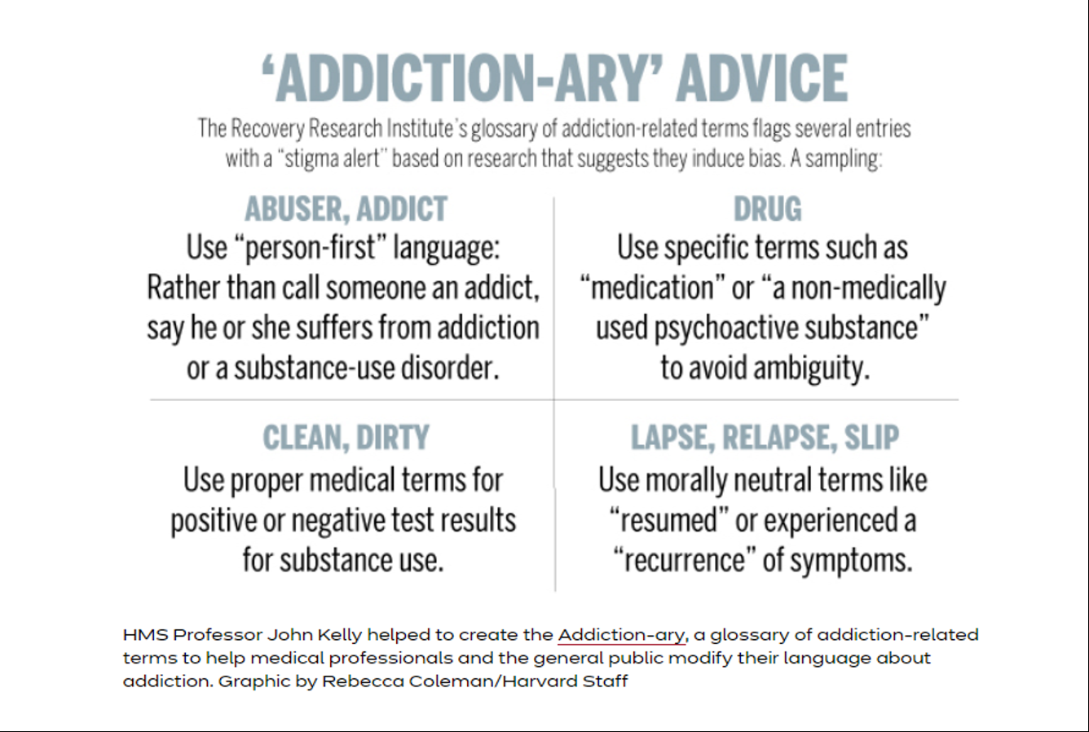
Reminder: Words Matter
Source: https://news.harvard.edu/gazette/story/2017/08/revising-the-language-of-addiction/

Slide 21
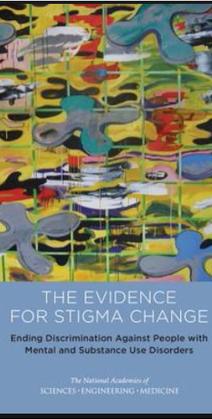
Recommended Reading
Ending Discrimination Against People with Mental and Substance Use Disorders: The Evidence for Stigma Change
https://www.ncbi.nlm.nih.gov/books/NBK384923/
Notes:
Personal Slide coming next
Ending Discrimination Against People with Mental and Substance Use Disorders: The Evidence for Stigma Change.
Show details Committee on the Science of Changing Behavioral Health Social Norms; Board on Behavioral, Cognitive, and Sensory Sciences; Division of Behavioral and Social Sciences and Education; National Academies of Sciences, Engineering, and Medicine.
Washington (DC): National Academies Press (US); 2016 Aug 3.
National Center for Biotechnology Information
National library of medicine
National institute of Health

Slide 22
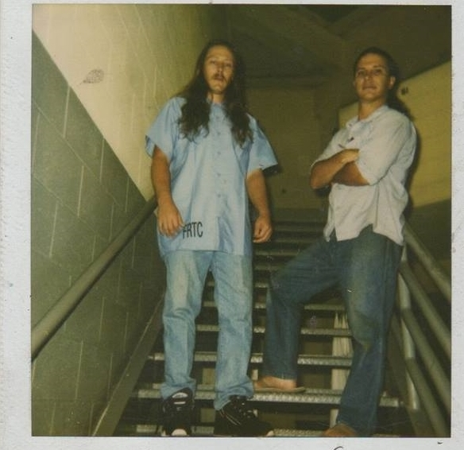

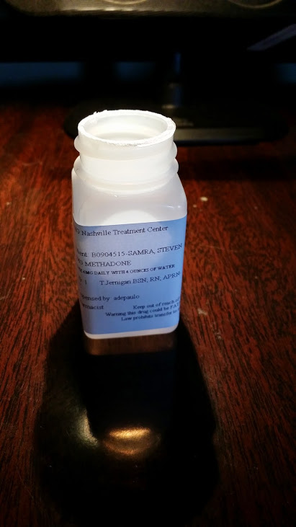
Wearing My Past On My Sleeve
MAT: 2000/2014
Detoxed 2/13/2014
Folsom Prison, drug conviction: 1996
Long Beach, CA: 1999
Waiting to die: opioid/cocaine addiction
Notes:
I typically would have shown this slide at the beginning of this presentation so everyone in the room knew that I had the lived experience that validates why I’m in front of you today.
But the reason I waited until the very end of this presentation to share a small snippet of my recovery story is because I know the pervasive impact of stigma personally, both in the context of addiction challenges and as a speaker/presenter.
I’ve said repeatedly during this presentation that Stigma may also keep ppl from seeking treatment. I was one of those people, and I’ll tell you why. 12 step story
I’ve been opioid medication free for 5 years now, and I stand in front of every one of you today wearing my past and my recovery on my sleeve, because if any of you had met me in 1998, you likely would have simply stepped over me laying in the gutter and would have never given me another thought. I’m in front of all of you today to tell you recovery is real, medication assisted treatment works, and with the right supports, those of us with substance use histories not only recover, we go on to do GREAT things in and for our communities, our brothers and sisters still struggling with addiction, and for the families that thought they lost us forever.
It is a pleasure to be here with all of you today, it is a massive pleasure to be alive, healthy and sober and I’m beyond grateful to the treatment and recovery teams who helped me, and I look forward to any questions or comments you may have.

Slide 23
Presenter Contact Info
Steven Samra
Opioid Response Network MAT/R Recovery Specialist
ssamra@C4innovates.com
Greg Perry
Director of Recovery Support Services
gperry@recoverypointwv.org

Slide 24
References
Addiction-stigma(2017). Retrieved from http://www.drugabuse.com.
Adlaf, E.M., Hamilton, H.A., Wu, F., & Noh, S. (2009). Adolescent stigma towards drug addiction: Effects of age and drug use behavior. Addictive Behaviors, 34(), 360-364.
Brown, S.A. (2011). Standardized measures for substance use stigma. Drug and Alcohol Dependence, 116(), 137-141.
Browne, T., Priester, M., Clone, S., & Iachini, A., DeHart, D., & Hock, R. (2015). Barriers and facilitators to substance use treatment in the rural south: A qualitative study. The Journal of Rural Health, 32(), 92-101.
Buchman, D.Z., Leece, P., & Orkin, A. (2017, Winter). The epidemic as stigma: the bioethics of opioids. Journal of Law, Medicine, & Ethics, 45(4), 607-611.
Johns Hopkins HUB. (October 1, 2014). Drug addiction viewed more negatively than mental illness, Johns Hopkins study shows.
Kelly, J.F., Walkerman, S.E. & Saitz, R. (2015, January). Stop talking 'dirty': clinicians, language, and quality of care for the leading cause of preventable death in the United States. The American Journal of Medicine, 128(1), 8-9.
Kramlich, D., Kronk, R., Marcellus, L., Colbert, A., & Jakub, K. (2018). Rural Postpartum Women With Substance Use Disorders. Qualitative Health Research, (), 1-13.
Notes:
.

